Slide 1
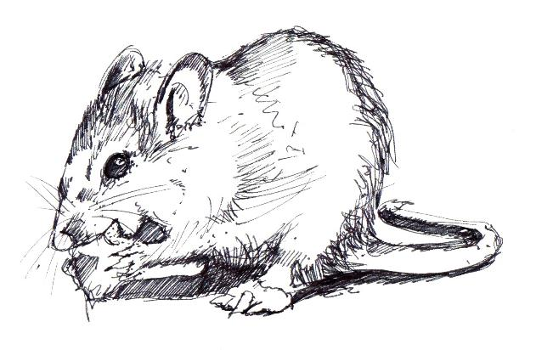
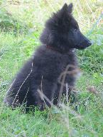
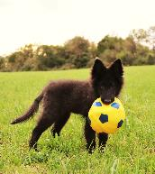
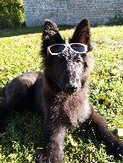
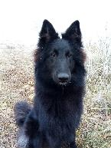
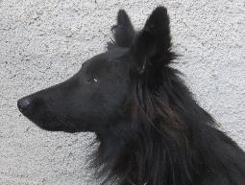
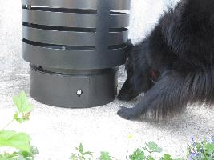
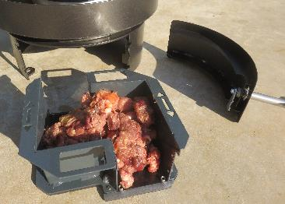
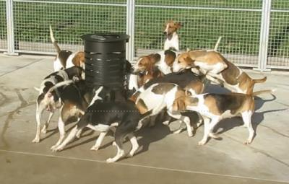
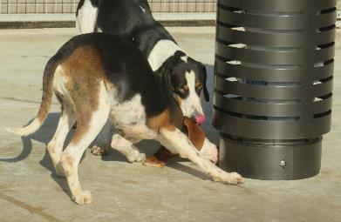
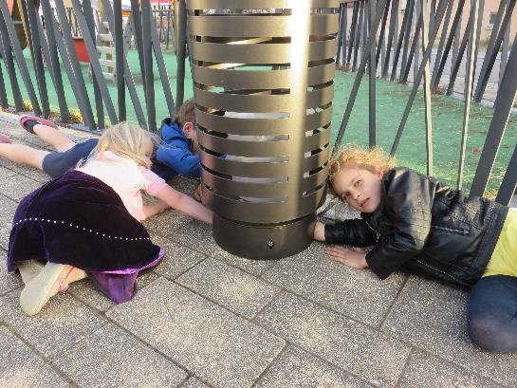
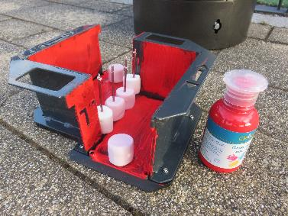
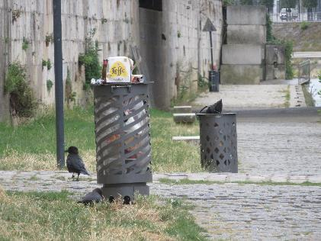
SECU-RAT, a public litter bin accessory as a new tool to monitor and control rat populations in the urban environment
SAFETY CONSIDERATIONS FOR CHILDREN, DOGS AND URBAN BIRDS
Mickael Sage ^{1,2}, Philippe Riehling ¹, Julien Hoffmann ¹, Vincent Schaller ¹, James Dat ¹
¹ SECU-RAT, 25 rue de la Grette – 25000 BESANCON – France ² Faune INNOV’ R&D, 25 rue de la Grette – 25000 BESANCON – France / contact@secu-rat.fr
INTRODUCTION
Rats pose a significant problem to society (zoonoses, severe property damage and food loss). The urban environment favours high population density, especially of the Brown rat (Rattus norvegicus). Increasingly high infestation levels are observed, in particular where human presence is high (e.g. urban parks, along riverbanks, where birds are fed or on picnic spots). Due to high food availability and the presence of attractive habitats in these areas, rat population control is particularly difficult and often ineffective.
SECU-RAT
Responds to the challenge of laying rodenticide baits and traps exactly where they are needed in an urban outdoor environment: under public bins.
Adapted for distance monitoring of rat populations and allows room for traps or rodenticide
baits that can only be accessed once it has been opened with a key.
Offers a high level of tamper-resistance for children and non-target animals (see the poster ‘Safety considerations for children, dogs and urban birds’), and is perfect for sensitive accounts where discretion is essential
Because optimal safety is required for children and for wild or domestic non-target species, we tested and validated our prototypes to protect children, dogs and urban birds.
Public bins are a crucial issue because they offer food to rats, but also because they fit into the urban outdoor environment and are often placed near rat habitats such as flowerbeds, bushes, etc
MATERIAL & METHODS - RESULTS
RESULTS
Children protection – Test 1
Dog protection – Test 1
Belgian shepherd Groenendael
2 – 12 months
Food inside Secu-Rat every 2 weeks during 10 min.
Children protection – Test 1
Efficacy 100%
ISO 8317
ISO 8317
Child-resistant packaging
Requirements and testing procedures for reclosable packages
Children 42-51 months
5 min. + demonstration + 5 min.
Every child must receive a package. They are asked to open it the way they want. Children should not be prevented from using their teeth or any other means to open the package.
Percentage of children on the panel who should not be able to open the package:
0 => 5 min: at least 85%
5 => 10 min: at least 80% among children who were unable to open the package during the first 5 min period.
Children protection – Test 2
Our own protocol
Age (year) | Enter the hand | Touch the paint | Touch the marshmallows |  | Cath the marshmallows
 |  |  | Entrance | Spit
3 | x | x | x | x | x
5 | x | x | x | x | x
7 | x | x | x | x | x
10 | x | x | x | x | x
Dog protection – Test 2
18 hunting dogs Anglos-Français x Ariégeois
Fasting since 48 hours
Minced meat (regular food) inside the drawer
10 min of exposure
Children protection – Test 2
Improve the drawer to obtain 100% of efficacy
whatever the age class
Our own protocol
Children 3, 5, 7 and 10 years old (hungry ☺)
Finger paint on the inside of the drawer
Marshmallow inside
Try to catch them…
10 min. of exposure
Dog protection – Test 1 & 2
Never acces to the food
Efficacy 100%
Urban birds
Presence of
Carion crow (Corvus corone)
Feral pigeons
(ex. Columba livia domestica)
Camera trap inside Secu-Rat during 2 weeks
Urban birds
Efficacy 100%
No picture inside the Secu-Rat
Manufactured in France to ensure quality and durability,
SECU-RAT is patented and compatible with different litter bin models and will be distributed internationally
Strand, T.M., and A. Lundkvist. 2019. Infection Ecology & Epidemiology, 9:1.
Pimentel, D., L. Lach, R. Zuniga, and D. Morrison. 2000. Bioscience. 50. 53-65.

