Slide 1
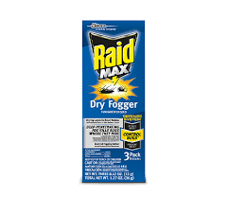
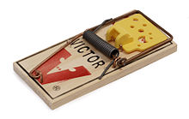
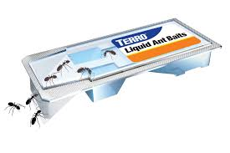
5 Key Concepts Every Urban Entomologists Should Understand About Developing Successful Consumer Insect Control Products
Stewart Clark – w.stewart.clark@gmail.com
#1UNDERSTAND THE TARGET INSECT
Ants – Terro* and Amdro* used this target to succeed
Roaches – Combat* baits and Raid** used this target
Mosquito – This insect launched OFF!**
THE KEY CONCEPT HERE IS SIMPLE.
DO NOT TRY TO BE ONE SIZE KILLS ALL. PICK THE INSECT
UNDERSTAND THE INSECT
STUDY THE TOP THREE SELLING BRANDS.
START YOUR MISSION TO FIND A BETTER WAY.
#3 Design a New and Novel Delivery System
#4 Keep all marketing and graphics simple….
Aim for a 5th Grade school level reader
3. Design a Clever and Efficient Delivery System
The Consumer Market is always ready for a new delivery system for home pest control
Examples …
The total release aerosols in the 1960’s
The Shell NO Pest Strip in the 1970’s
Combat Bait Stations for roaches 1980’s
Enforcer High Delivery Rate Wasp Spray 1990’s
Terro Liquid Ant bait stations 2000’s
Thermacell Personal Mosquito repellent dispenser
#5 Launch your Startup inside your current company
\#2….
UNDERSTAND THAT EFFICACY IS NOT THE ONLY ISSUE IN THE CONSUMER MARKET…….
WHILE IT IS GREAT IF YOUR NEW PRODUCT WORKS EVERYTIME ALL THE TIME IN THIS MARKETPLACE THERE ARE OTHER ISSUES JUST AS IMPORTANT TO YOUR ULTIMATE SUCCESS.
START WITH A COMPLETE UNDERSTANDING OF THE REGULATORY REQUIREMENTS FOR YOUR IDEA BEFORE PROCEEDING

