Slide 1
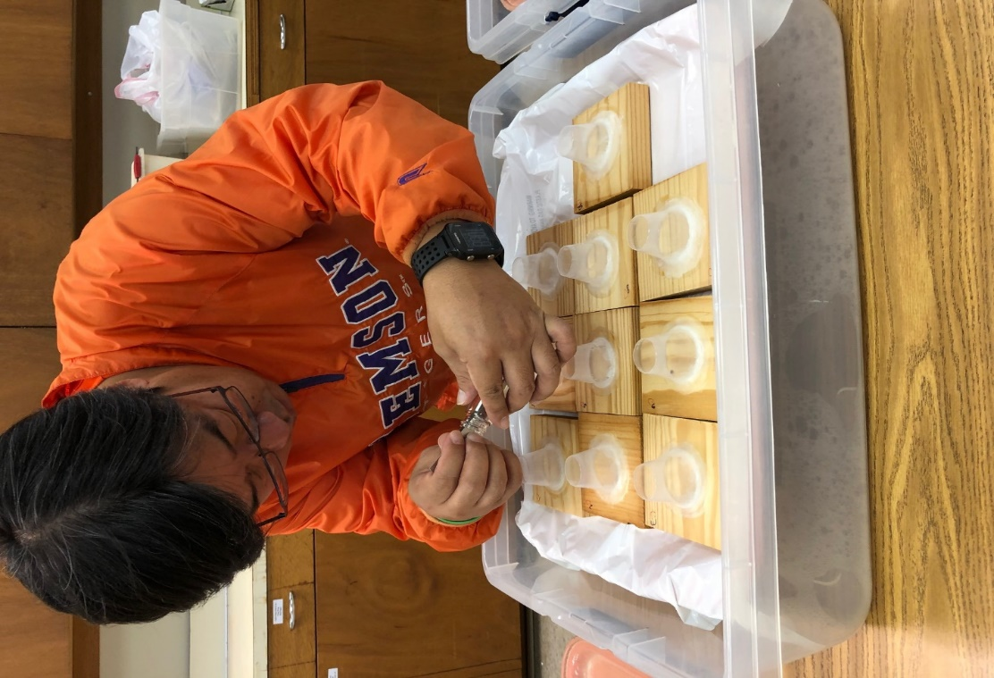
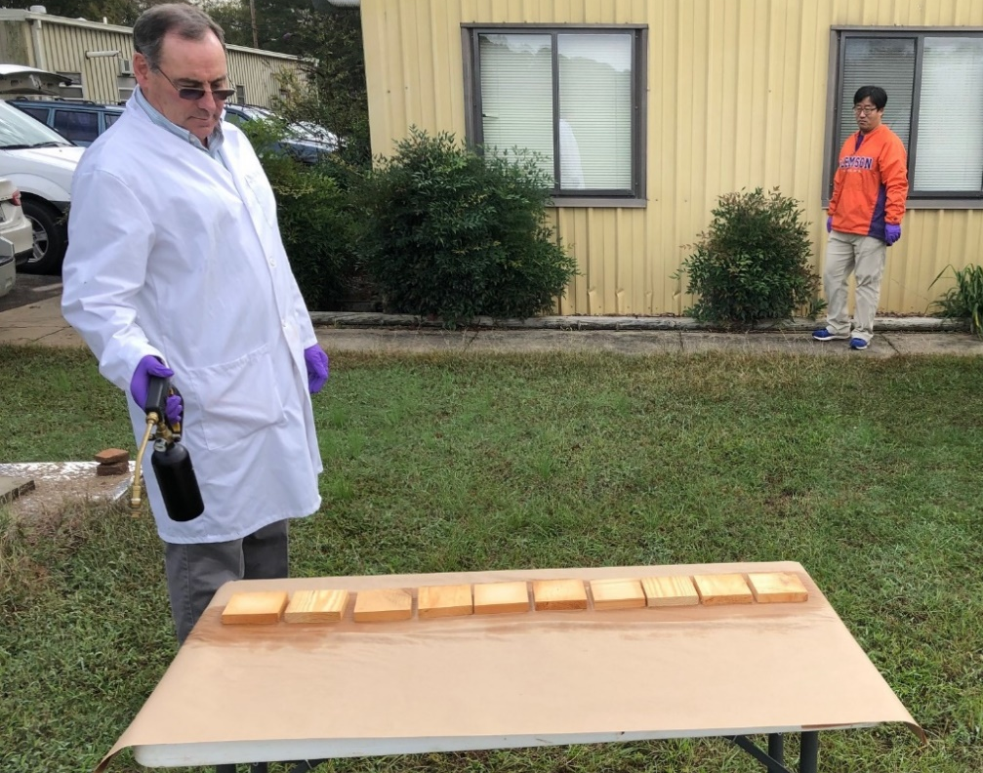
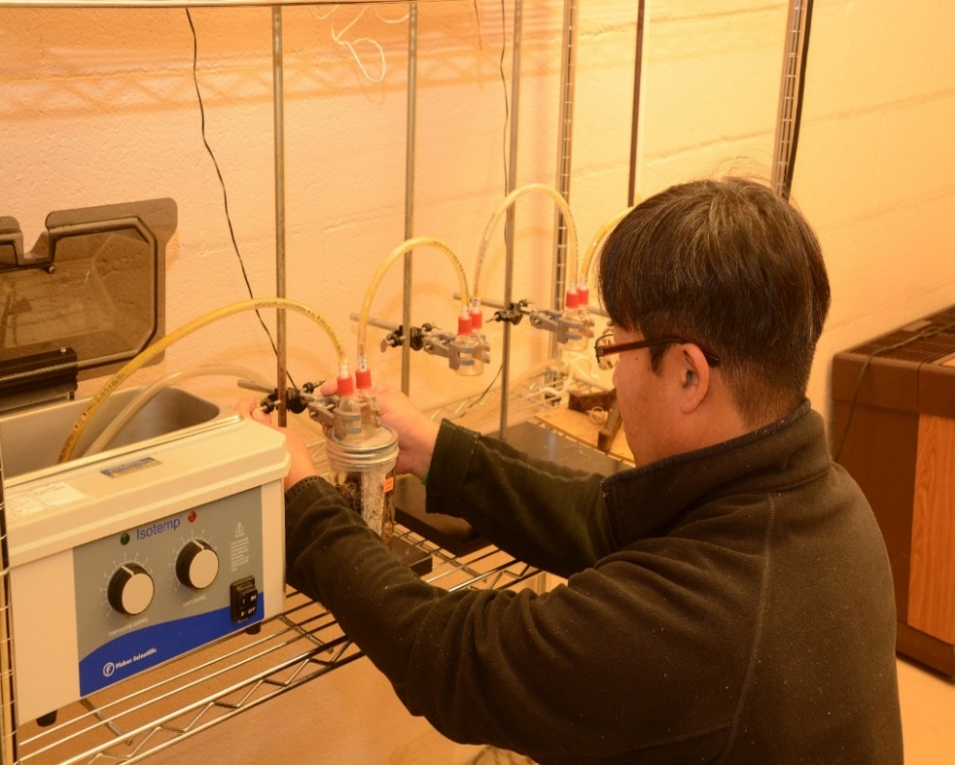
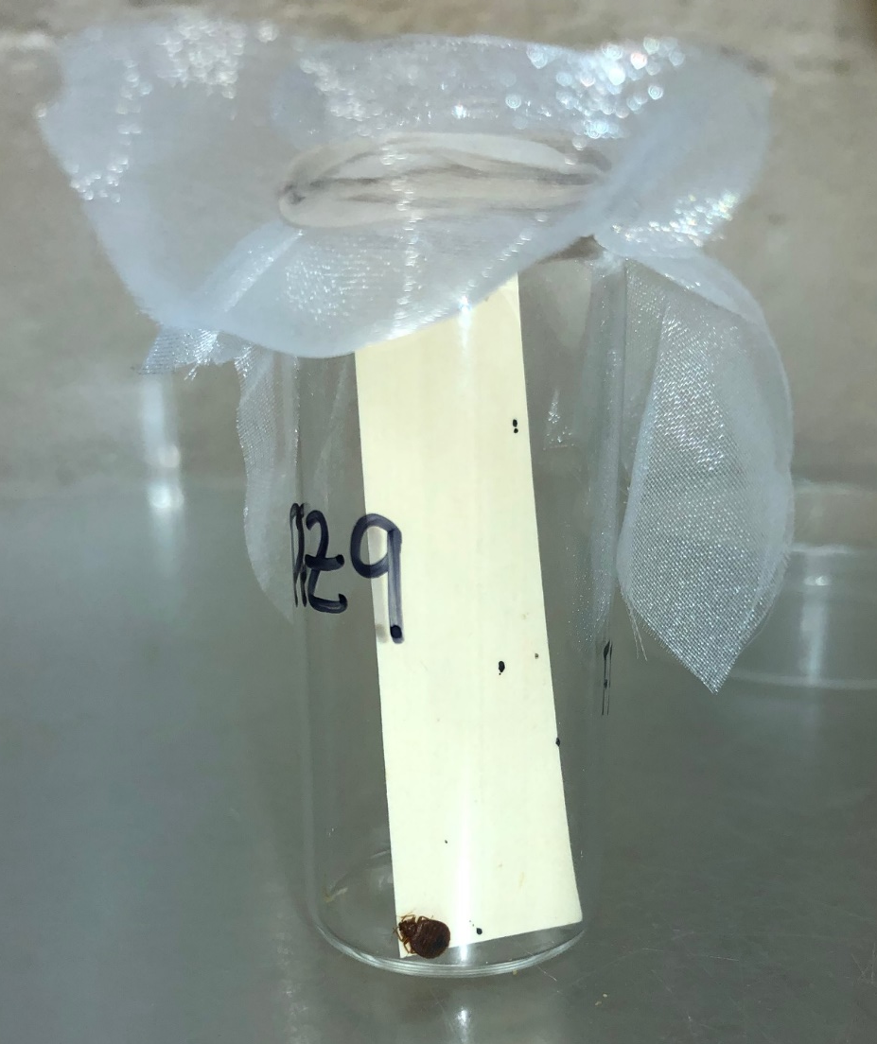
Impact of sub-lethal deltamethrin exposure on fecundity of pyrethroid resistant male bed bugs
Eric P. Benson, Patricia A. Zungoli, Jinbo Song, and Brittany R. Ellis
Department of Plant and Environmental Sciences
Clemson University, South Carolina, USA
Eric Benson
INTRODUCTION
After the resurgence of bed bugs, Cimex lectularius L., (Heteroptera; Cimicidae) two decades ago, a variety of insecticides have been evaluated for bed bug control. Pyrethroid insecticides have commonly been used to control bed bug populations; however, some field strains of bed bugs have varying levels of resistance to pyrethroids including deltamethrin. Sub-lethal exposure to pyrethroid insecticides in previous studies have been shown to affect reproduction, fecundity, development time, and hatch rate of female bed bugs. The purpose of this study was to evaluate sub-lethal dose effect of deltamethrin on the reproduction of resistant male C. lectularius.
RESULTS AND DISCUSSION
There was no significant difference between the mean number of eggs laid per control female and the females mated with deltamethrin exposed males (Figure 7), 12.4 and 12.0 respectively (p=0.4339). There was no significant difference between the mean number of nymphs hatched from control female eggs and the eggs of females mated with deltamethrin exposed males, 11.77 and 11.22 respectively (p=0.4663). There was also no significant difference in the mean proportion of nymphs hatched from control female eggs and the eggs of the females mated with deltamethrin exposed males, 85.13% and 85.41% respectively.
A
Figure 3. Exposure of males to treated surfaces
Figure 4. Exposure of 30 minutes to treated surface
After the preliminary exposure test, twenty Jersey City, deltamethrin resistant virgin male bed bugs were fed on the same day
(Figure 2) that wood panels were treated with deltamethrin or water for the control. Ten bed bug males were exposed to deltamethrin treated wood panels (Figure 3) and ten bed bug males were exposed to the water treated wood panels for 30 minutes at 24 hours post treatment (Figure 4) and then removed to a clean vial. Twenty virgin, Jersey City females were given a blood meal three days post-treatment and immediately introduced at a 1:1 ratio to the either the deltamethrin exposed males or the water exposed males for mating. Twenty-four hours after mating, the females were moved to a clean glass vial to lay eggs (Figure 5). After 10 days when no new eggs were recorded, all females were removed from the vials. The average number of eggs per female and egg hatch rate was calculated. First instar nymphs were fed 7 days (Figure 6) after eclosion and monitored for successful molting to second instar.
A
Treatment | Control | Deltamethrin
Total Eggs | 12.4 ± 1.52 | 12.0 ± 1.82
Prop. Eggs Hatched | 0.851 ± 0.097 | 0.854 ± 0.097
Total Nymphs | 11.7 ± 1.45 | 11.5 ± 1.83
Figure 1. Treatment of raw wood panels
Figure 2. Feeding virgin male C. lectularius
Figure 7. Comparing fecundity of male bed bugs after 30 min exposure to treated surface.
CONCLUSION AND FURTHER RESEARCH
Understanding sub-lethal impacts of treatment on all stages of bed bugs is important when assessing control options and strategies. In this study there were no significant differences in the fecundity of deltamethrin resistant male bed bugs after a sub-lethal exposure. However, differences may have been detected under different experimental conditions. For example, longer direct exposure times, more incidents of repeated exposure, or different combinations of male and female bed bug exposure to deltamethrin may have produced differences in fecundity and should be investigated under future studies.
MATERIALS AND METHODS
The deltamethrin-based product Suspend Polyzone (4.75% deltamethrin, 95.25% other ingredients; Bayer Environmental Science) was applied to 10.16 cm² raw wood panels at the 0.03% label rate using a compressed air sprayer (B&G Pistol Pro sprayer) at 25 psi (Figure 1). Control panels were treated in the same manner using distilled water. All treated wood was allowed to dry 24 hours. One plastic medicine cup (30 ml) with the bottom removed was inverted and secured to each treated panel using heated paraffin wax to prevent bed bug escape. A preliminary 30 minute exposure test using five virgin male Harold Harlan strain, pyrethroid susceptible, bed bugs was performed in conjunction with five virgin Jersey City, NJ, USA, deltamethrin resistant (>300X resistant to topical deltamethrin application) male bed bugs. There was 100% mortality and moribundity at 24 hours post-exposure for susceptible males, while 100% of the resistant males were alive.
Figure 5. Female C. lectularius in isolation vial after mating.
Figure 6. Egg cases and 1st instar nymphs

