Slide 1
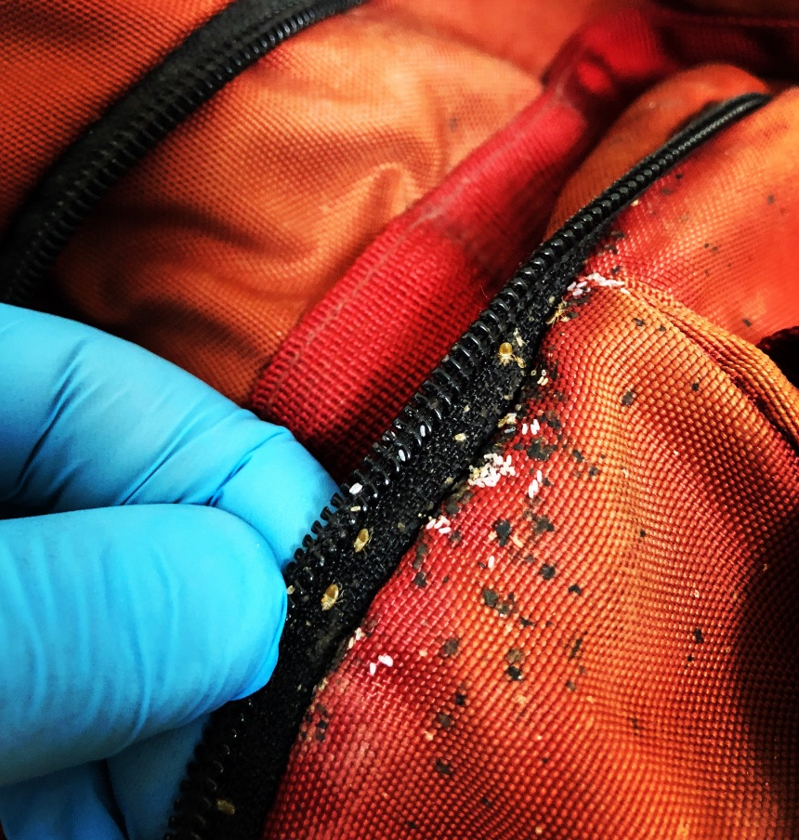
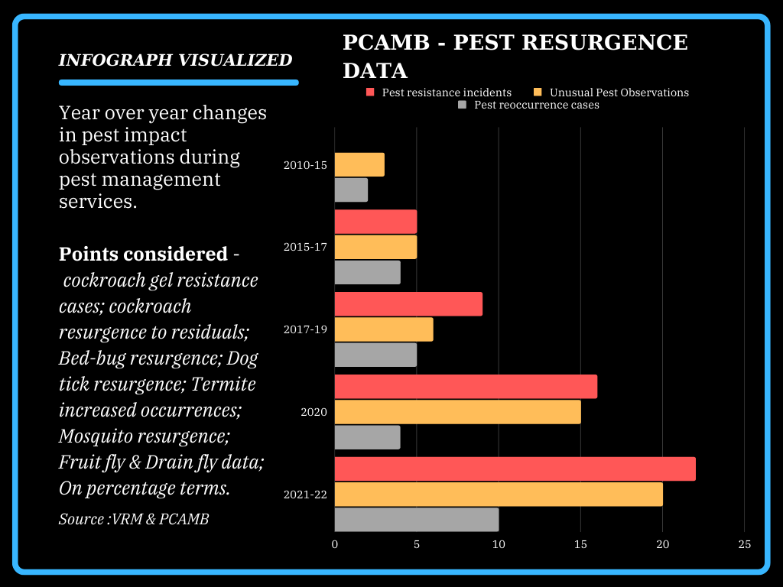
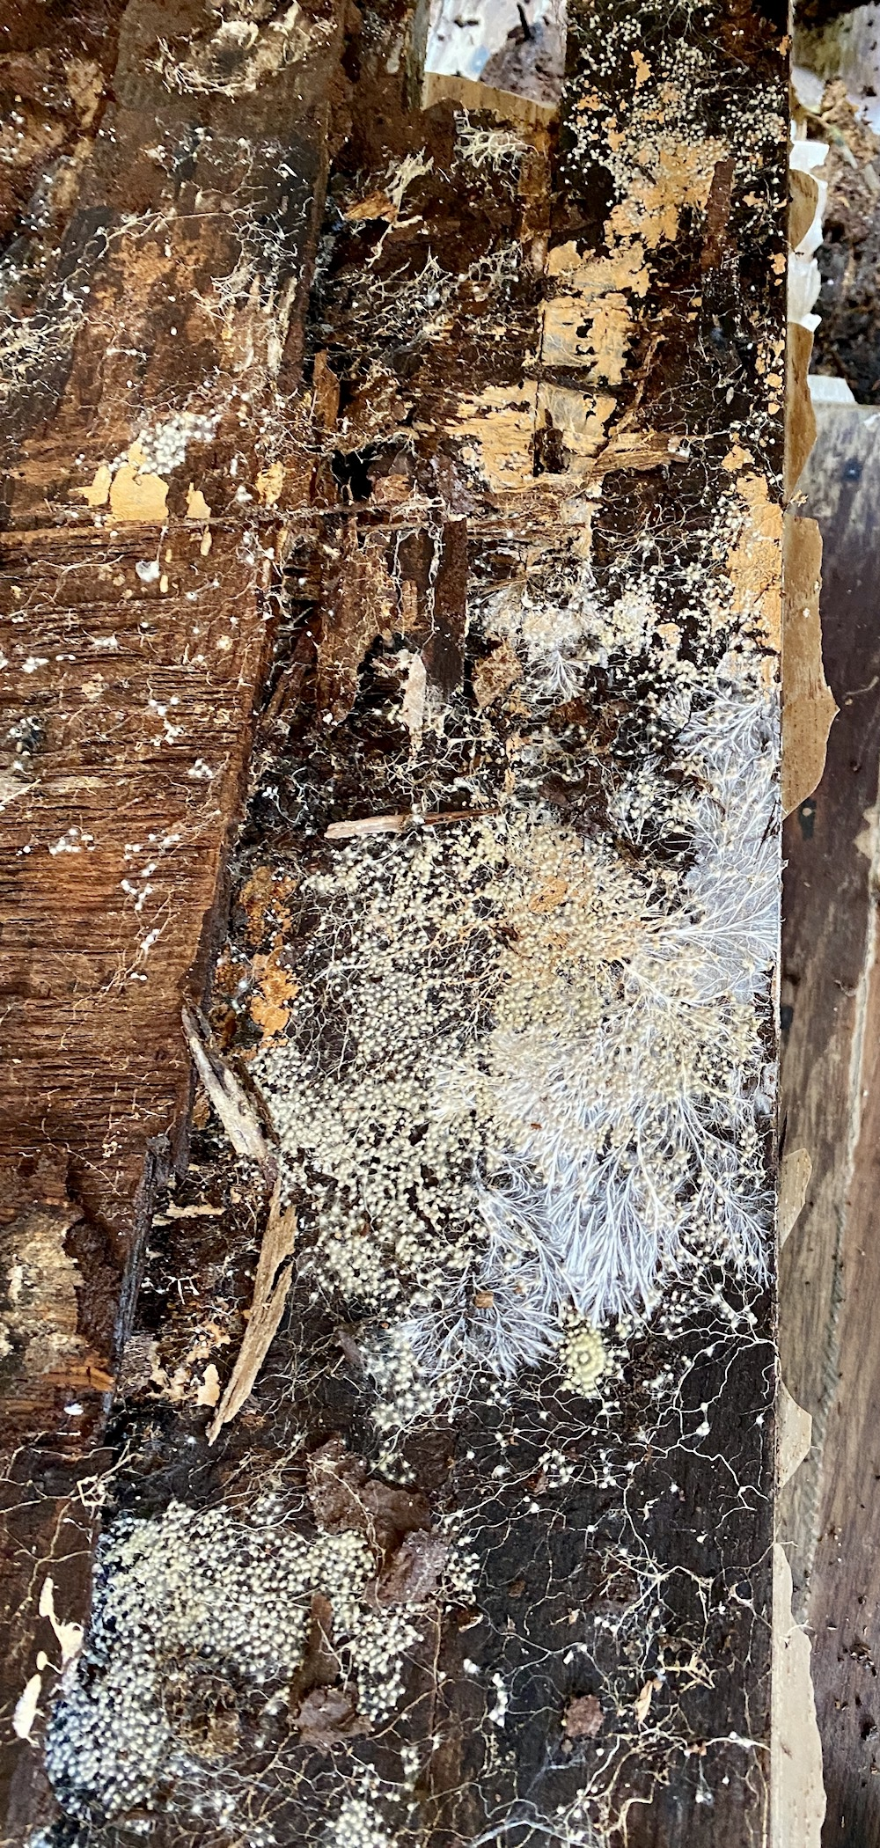
Sustainability of IPM Strategies in the current environment of Pest Resurgence
Viren R. Merchant - Director PCAMB, Professional Speaker
Introduction
This era is witnessing pest emergence in human occupied spaces utilising different situations & property conditions to advance their development & ingress, making it challenging for global IPM professionals to manage.
Inference
Conclusions
Comprehensive study required on real life data (field) of pest related public health impact, operational & economic loss, in relation to sustainability goals.
Required, holistic approach and stakeholder collaboration amongst the IPM fraternity - Academia, Businesses, Authorities to develop a sustainable integrated strategy to deal with pests, while safeguarding people, property and environment.
I wish to link all the above IPM stakeholders, collaborate on real data & utilise it to innovate for better effective IPM solutions.
Materials and methods
Practical on-field experience of 20+ years, collaborating with PCO’s in India & data collected from client inquiries & services.
Referred research papers, news articles, industry’s global conferences & publications.
Termite ingress & penetration impact on structures has intensified in past 5 years based on service data collected. Severity of termite presence & related damage, is compounded by the interesting additional observations of white fungus like threads usually called hyphae, and fruiting bodies / spores within the affected wooden fixtures, particularly wooden flooring.
Literature cited
Insecticide Resistance, and Its Effects on Bait Performance in Field-Collected German Cockroaches From Taiwan -by I-Hsuan Hu, Shan-Min Chen, Chow-Yang Lee, Kok-Boon Neoh - 28 March 2020;
Rapid evolutionary responses to insecticide resistance management interventions by the German cockroach -by Mahsa Fardisi, Ameya D. Gondhalekar, Aaron R. Ashbrook & Michael e. scharf - 05 June 2019
Acknowledgments
Journal of Economic Entomology; Journal of Building Engineering - Science Direct; Pest Control Associates (AMB) Pvt Ltd client data;
Cockroaches may soon be unstoppable—thanks to fast-evolving insecticide resistance - Science Shots article 28 JUN 2019, By Kelly Mayes; Across the globe News articles on pest impacts;
Further information
Please contact on virenmerchant@pcamb.com or +91-9820647436.
https://www.linkedin.com/in/virenmerchant/

