Slide 1
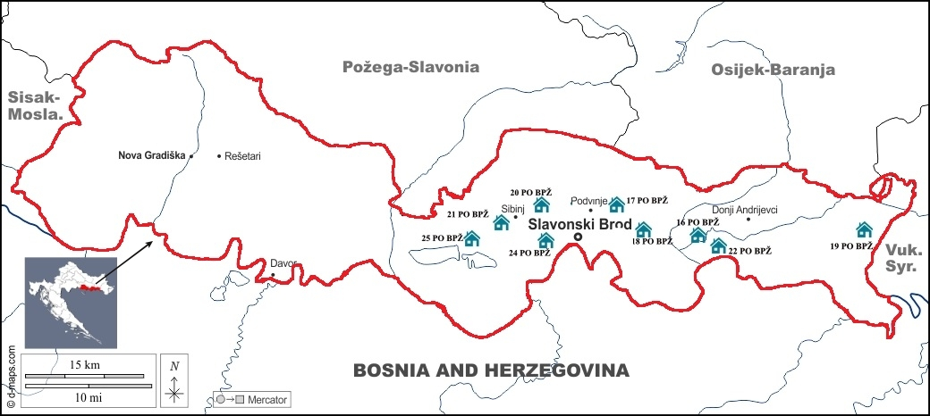
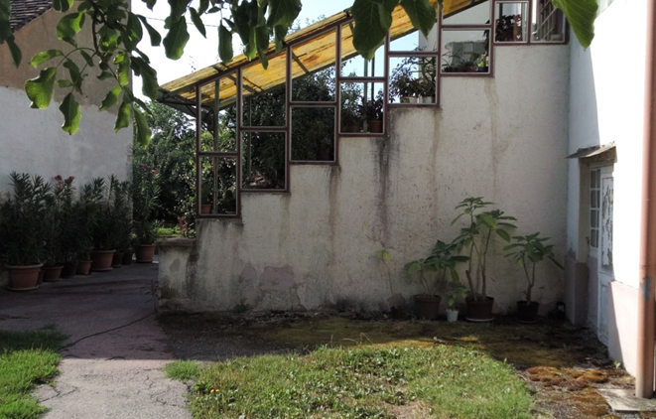
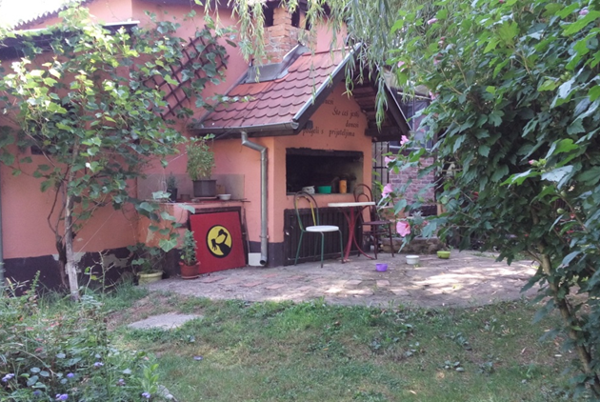
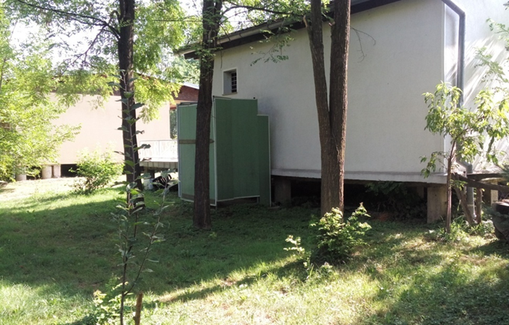
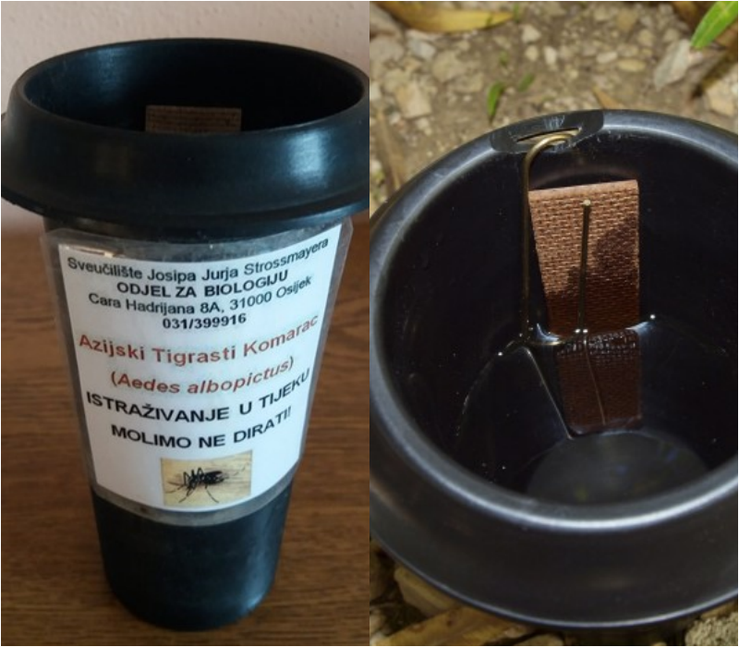
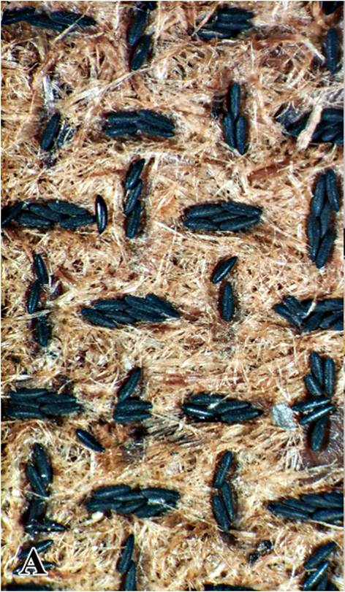
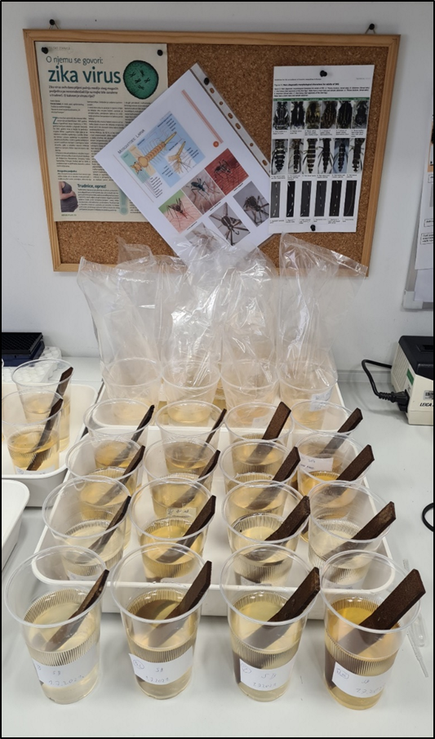
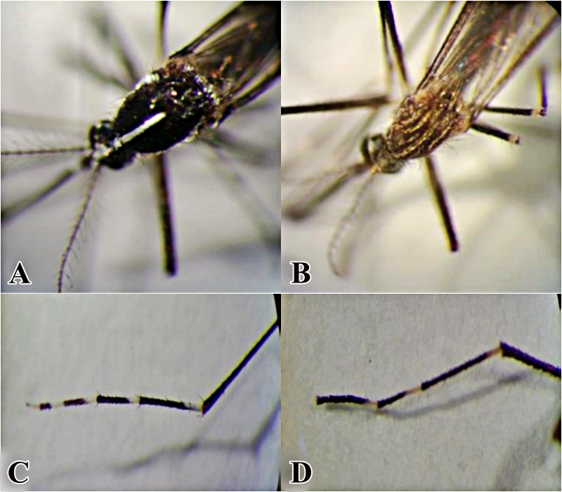
Residential Backyards – Places for the Spread of Invasive Mosquito Species
Mirta Sudarić Bogojević¹, Iva Jurčević¹, Ante Cvitković², Marijana Valjetić²
¹Department of biology, Josip Juraj Strossmayer University of Osijek, Cara Hadrijana 8a, 31000 Osijek, Croatia (mirta.sudaric@biologija.unios.hr)
² Public Health Institute of Brod-Posavina County, Vladimira Nazora 3a, 35000 Slavonski Brod, Croatia
INTRODUCTION
Invasive mosquito species (IMS) are an important public health challenge due to their great vector potential. Climate change, increasing urbanization and human negligence have enabled their wide distribution [1, 2]. Regarding that, in 2016 the IMS monitoring program in Brod-Posavina County (Eastern Croatia) was started as part of the national mosquito monitoring program in the Republic of Croatia, which has been successfully continued to the date. Already in 2016, the first findings of Aedes (Stegomyia) albopictus (Skuse, 1895) was recorded, and a year later Aedes japonicus japonicus (Theobald, 1901) was also confirmed [3, 4]. The aim of this five-year study was to present the seasonal dynamic of IMS on private properties as suitable places for the spread of IMS. As part of this research, the knowledge of the local inhabitants about IMS was examined using a questionnaire.
MATERIALS AND METHODS
Figure 1. Locations of residential backyards – ovitraps in the Brod-Posavina County.
Oviposition trap was used for simple and effective sampling of IMS of the genus Aedes (Figure 3).
Ovitraps have been set in residential backyards in the area of Slavonski Brod and it’s surroundings (Figure 1 and 2).
Laboratory rearing of the larval stages took place under the following conditions: water temperature 23°C and air temperature 25°C (Figure 4).
Mosquitoes were morphologically identified at the species level using taxonomic key (Figure 5) [5].
The dynamics of paddle collection and replacement, as well as the specifics of each season are summerized:
16/5 - 31/10
2019
8 locations
21/6 - 5/11
2020
7 locations
18/5 - 30/11
2021
7 locations
15/6 - 8/11
2017
6 locations
14/6 - 14/11
2018
8 locations
Figure 2. Residential backyards in the Brod-Posavina County.
(Bi)weekly ovitraps replacement / inspection
The questionnaire was conducted using Google forms and shared through social networks. The collection of responses took place from 21st April to 30th May 2022. A total of 150 respondents participated.
Figure 3. Oviposition trap.
B
Figure 4. Invasive Aedes mosquito eggs on hardboard paddle (A) and mosquito rearing in laboratory (B).
Figure 5. Morphological characteristics
of the adult mosquito: Aedes albopictus
(A, C) and Aedes japonicus (B, D).
RESULTS AND DISCUSSION
The number of invasive Aedes mosquito eggs collected in residential backyards accounted from 16% to 40% (Figure 6).
The highest number of eggs was collected in 2019, when the average number of eggs per residential backyard ovitrap was 1782 eggs (Figure 7).
Oscillations in the numbers of eggs through the seasons are the consequence of different weather conditions, as well as different numbers of ovitraps set in residential backyards (in 2017 residential backyards accounted for 29% of total locations, in 2018 and 2019 year 33% and 32%, and in year 2020 and 2021 28%) (Figure 8).
Aedes albopictus has been successfully spread in all locations, while Aedes japonicus appears sporadically, mostly at residential backyard locations where it appears together with Aedes albopictus (Figure 9).
The main association of respondents for IMS is that they do not belong to this region. Also, most respondents associate IMS with river habitats (Figure 10 A and B).
52% of respondents believe that residential backyards are places of great potential for the development of IMS, while 48% of them believe the opposite (Figure 10 D).
45% of respondents think that residential backyards in their place are regularly maintained, while the others disagree (Figure 10 E).
Most respondents are not familiar with the implementation of IMS national monitoring (Figure 10 C) and the use of Bti – based insecticides (Figure 10 F), but are willing to use them as recommended by profession (Figure 10 G). Also, over 80% of respondents would support the funding of IMS control program in the Brod-Posavina County (Figure 10 H).
Monitoring in residential backyards
Figure 6. Proportion of invasive Aedes mosquito eggs in the total number of eggs over a five-year period in residential backyards.
Figure 7. Average number of eggs per trap over a five-year period in residential backyards.
Figure 8. Proportion of invasive Aedes mosquito eggs over a five-year period in each ovitrap in residential backyard.
Figure 9. Distribution of species of the genus Aedes in residential backyards over a five-year period.
CONCLUSIONS
Questionnaire
Residential backyards, especially those improperly maintained in the urban and suburban region of the Brod-Posavina County, are one of the leading breeding sites for IMS. The continuously high proportion of collected eggs in residential backyards during five-year monitoring indicates a lack of local community participation in preventing the reproduction and spreading of IMS. This is supported by the results of the questionnaire which present an insufficient knowledge on IMS biology and ecology. Nevertheless, there is a willingness of the local population to further support the monitoring and apply adequate control methods.
FURTHER RESEARCH
We recommend launching and strengthening the national and local education programs about IMS as the most effective preventive method in the IMS control program. The direct involvement of all participants through various forms of citizen science and popular science lectures is necessary to drive change.
Figure 10 A - H. Respondents’ answers to the questions.
[1] Medlock, J. M., Hansford, K. M., Schaffner, F., Versteirt, V., Hendrickx, G., Zeller, H., Bortel, W. V. (2012) A review of the invasive mosquitoes in Europe: ecology, public health risks, and control options. Vector-borne and zoonotic diseases 12(6), 435-447.
[2] Petrić, D., Bellini, R., Scholte, E. J., Rakotoarivony, L. M., Schaffner, F. (2014) Monitoring population and environmental parameters of invasive mosquito species in Europe. Parasites & Vectors, 7(1), 1-14.
[3] Terzić, I., Cvitković, A., Merdić, E., Sudarić Bogojević, M. (2018) Prisutnost invazivnih vrsta komaraca na području Brodsko-posavske županije. DDD i ZUPP 2018 - invazivne strane vrste - izazov struci. 30. znanstveno-stručno-edukativni seminar s međunarodnim sudjelovanjem, Korunić.d.o.o., Zagreb, 67-82.
[4] Sudarić Bogojević, M., Terzić, I., Cvitković, A., Jurić, D., Zahirović, Ž. (2019) Uloga ovipozicijske klopke u kontroli invazivnih vrsta komaraca na području Brodsko-posavske županije. DDD i ZUPP 2019 - otpad - ekološka niša, 31. znanstveno-stručno-edukativni seminar s međunarodnim sudjelovanjem, Korunić d.o.o., Zagreb, 113-127.
[5] Becker, N., Petric, D., Zgomba, M., Boase, C., Madon, M., Dahl, C., Kaiser, A. (2010) Mosquitoes and their Control. (2 ed.) Springer. https://doi.org/10.1007/978-3-540-92874-4.

