Slide 1
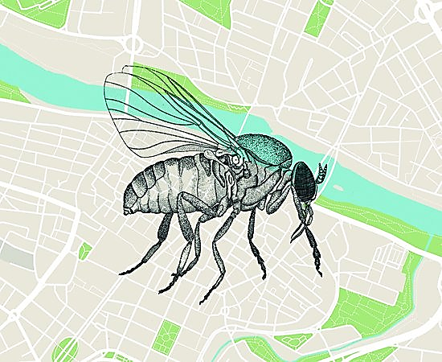
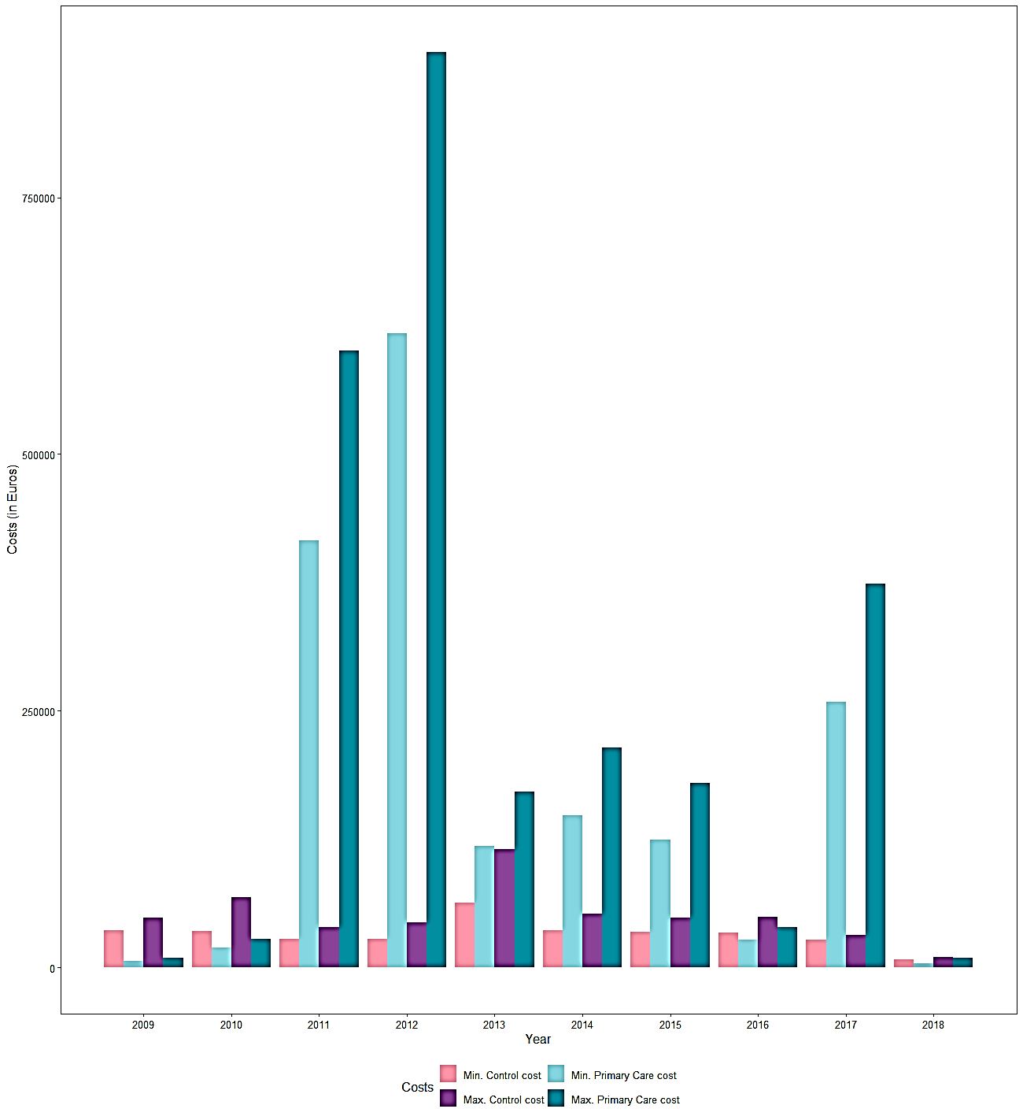
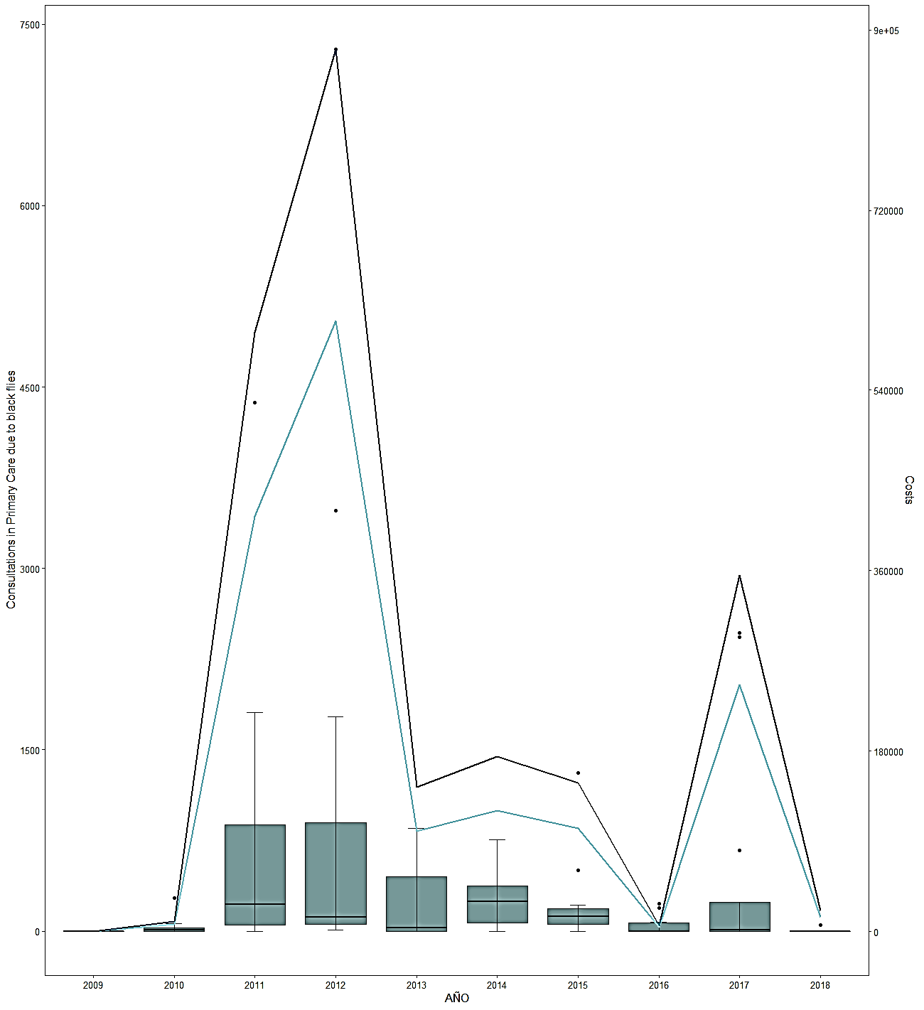
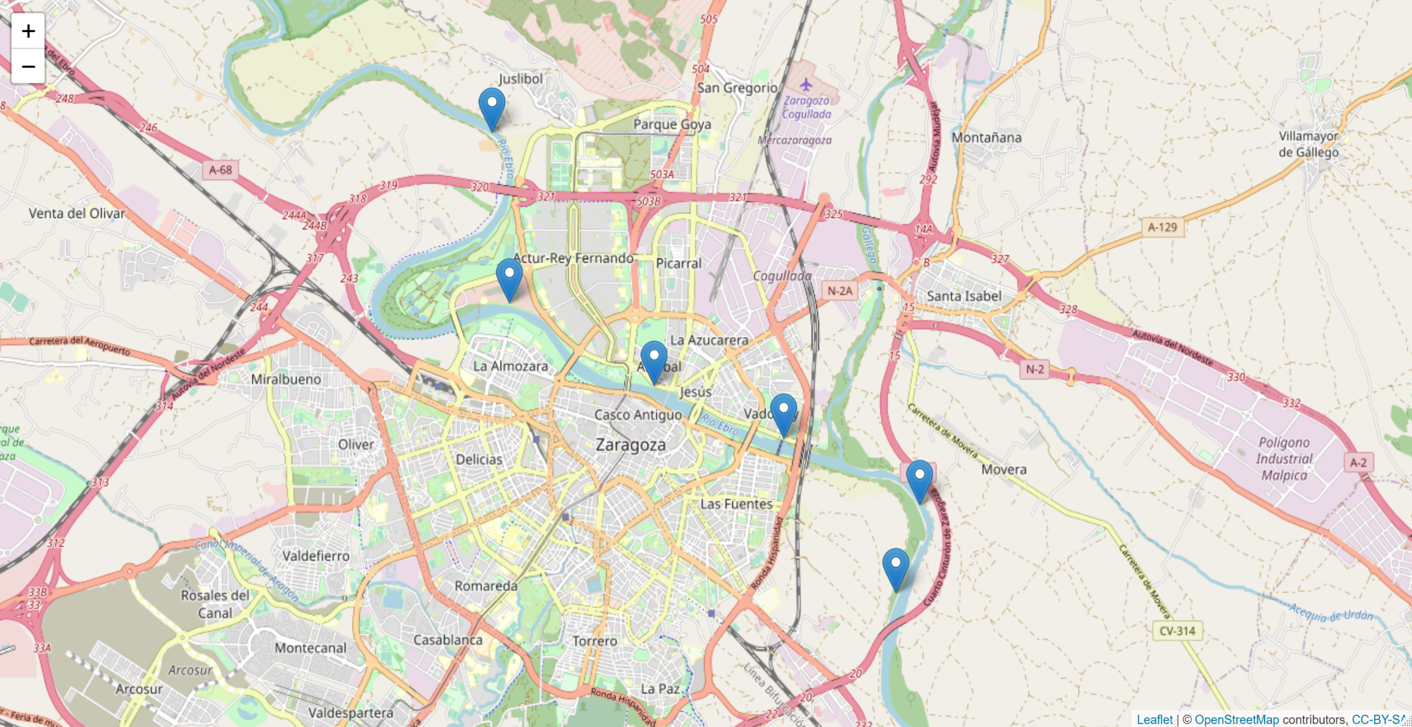
Health and control costs of blackflies in a pest hotspot at Spain
Laura Blanco Sierra¹ , Ignacio de Blas Giral² , José A. Oteo³ , Ignacio Ruiz Arrondo³
¹ Center of Advanced Studies of Blanes (CEAB-CSIC), Blanes, Girona, Spain
² Instituto Agroalimentario de Aragón IA2 (Universidad de Zaragoza - CITA), Zaragoza, Spain
³ Center for Rickettsiosis and Arthropod-Borne Diseases, Hospital San Pedro-CIBIR, Logroño, Spain
Introduction
Simulium erythrocephalum (Diptera: Simuliidae), of hematophagous nature, is very abundant in the lower courses of rivers, prefers to feed on mammals, including humans, and makes it one of the main pest species in Spain and Europe, with a significant impact on the Public and Animal Health.
In the city of Zaragoza there has been an increase in visits to Primary Care centers and hospitals due to the inconvenience caused by bites, which leads to an increase in public spending and the saturation of the health system.
The economic cost of health care for insect bites in the city of Zaragoza has been analyzed and compared with an estimate of the cost of the control carried out through the purification of the Ebro river during the period 2009-2018.
Results
Conclusions
The implementation of an effective control of the larval populations of blackflies through the treatment of the Ebro river allows reducing the health cost of this pest in the area.
Given the great flight capacity of this insect, control should not be limited only to the urban area of Zaragoza, but include other sections further away from the city and nearby towns where there are larval foci and control is not being carried out.
The control of the blackfly plague would reduce its impact on Public and Animal Health and would substantially improve the well-being of citizens in the summer season.
The years 2011 and 2012, followed by 2017, were the most affected by the presence of blackflies. The years 2010, 2016 and 2018 have the lowest rates of black fly attention; the years prior to 2011 and 2012 (when the outbreak occurred) have very low records because no massive presence of simulids had been detected (Figure 2).
An estimation was made on the cost of a Primary Care consultation in Aragon, taking €45 and €65 as minimum and maximum respectively. The fluctuations in the minimum cost (light line) and in the maximum cost (dark line) per year follow the same pattern observed for the number of consultations in Primary Care associated with black flies (boxplot).
Materials & methods
Data on consultations for insect bites in Primary Care (and bites attributed to the black fly) were analysed on a monthly and annual basis; analysing both total consultations for bites and those referring to 10,000 total consultations in Primary Care.
To estimate the cost of black fly control, the amount of product used (VectoBac® 12 AS) in the treatments (Figure 1) was estimated taking into account the minimum and average flow rates recorded for the years studied. The cost of the personnel who carry out the treatment, travel and analysis of the samples was also taken into account.
Figure 1. Map of the city of Zaragoza, with the points of the river where the treatments were carried out
Further research
The control of black fly populations is an ongoing challenge in urban areas that requires significant efforts. Basic knowledge of the bioecology and phenology of the species involved is vital for good control.
This pest is affecting more and more Spanish cities and is a growing Public Health problem, so it is very important to identify the factors involved in the massive development of blackfly populations.
Figure 3. Costs of black fly control and costs of consultations in Primary Care attributed to black fly bites.
The years in which the cost of control is lower, the health cost increases (Figure 3). When the flow rate is lower, the volume of product used is less and therefore the cost of control is lower; however, the lower flow rate favours the presence of black flies, resulting in a greater number of bites and more medical attention.
Even if expenditure on control were to increase in peak years, the cost would still be less than the cost of health care. However, as spending on control increases, one would expect to see a reduction in the insect population and thus a reduction in the number of medical attention.
Figure 2. Comparison between the amount of consultations in Primary Care associated to blackfly bites (boxplot) and the mínimum (light line) and máximum (dark line) costs attributed to the consultations due to blackfly bites, per year
References
Ruiz‐Arrondo I, Alarcón‐Elbal PM, Figueras L, Delacour‐Estrella S, Muñoz A, Kotter H, Pinal R, Lucientes J. 2014a. Expansión de los Simúlidos (Diptera: Simuliidae) en España: Un nuevo reto para la Salud Pública y la Sanidad Animal. Boletín de la Sociedad Entomológica Aragonesa. 54: 193‐200.
Ruiz Arrondo I. 2018. Estudio de Simulium erythrocephalum (De Geer, 1776) en Zaragoza: ecología e impacto en salud pública. Tesis Doctoral. Universidad de Zaragoza.
Peláez Guerra MA. 2018. Estudio observacional del número de atenciones por picaduras de insecto en la ciudad de Zaragoza en el periodo 2009‐2017. Relación con determinados parámetros medioambientales. Trabajo Fin de Máster. Instituto de Salud Pública Carlos III.
Ruiz‐Arrondo I, Lucientes J. 2011. Informe sobre los tratamientos realizados contra las larvas de mosca negra en Zaragoza en junio y julio 2011. Universidad de Zaragoza.
Muñoz Otero A, Oresanz Martínez I, Ruiz‐Arrondo I. 2018. Informe sobre el control de simúlidos en la Mancomunidad del Bajo Gállego. Centro de Investigación Biomédica de La Rioja (CIBIR).

