Slide 1
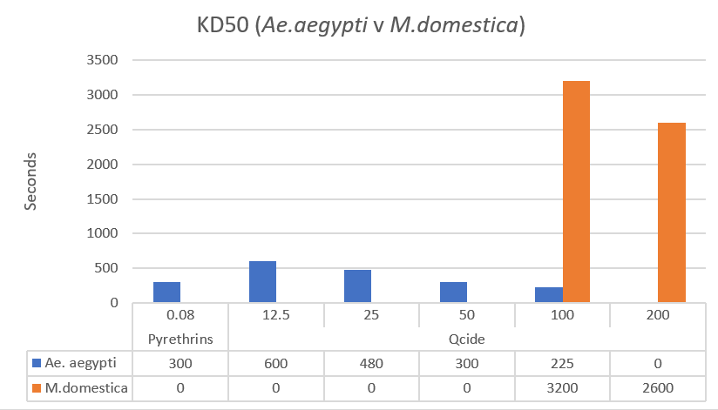
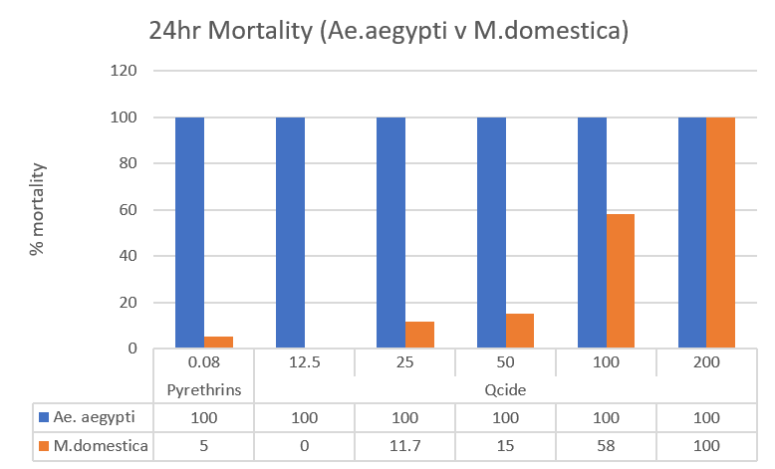
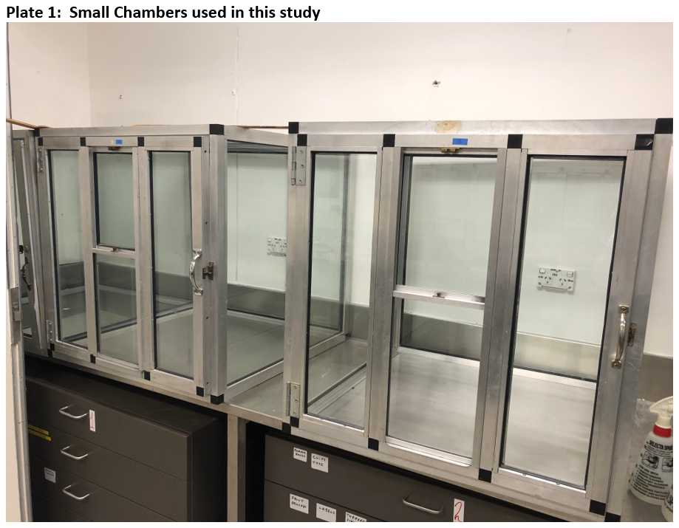
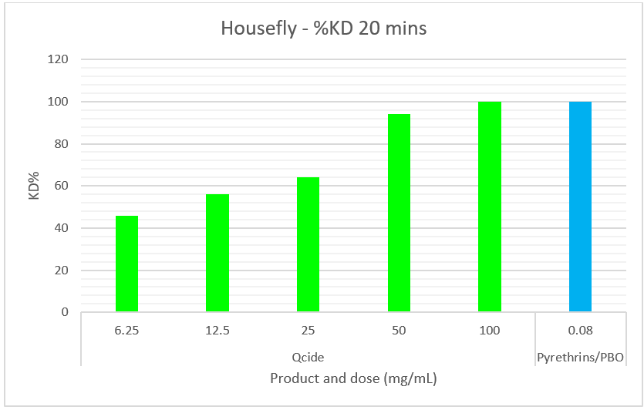
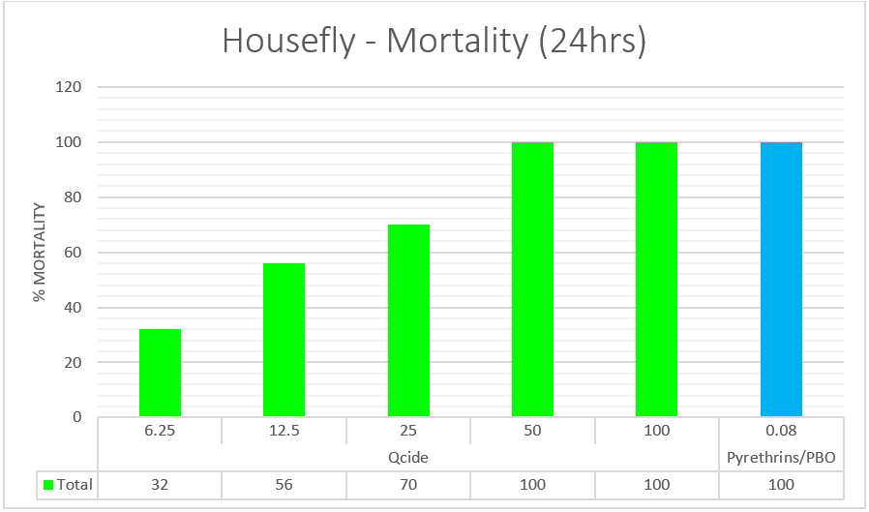
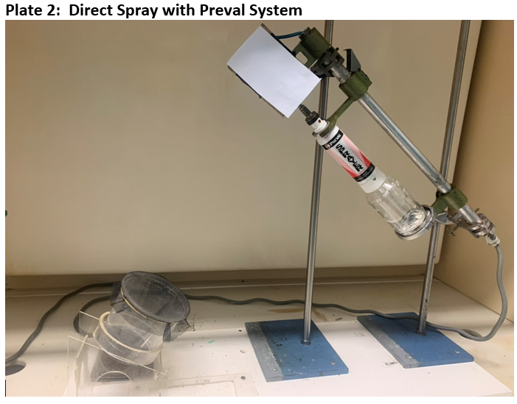
QCIDE®: NATURAL INSECTICIDE FOR THE CONTROL OF FLYING INSECTS
¹PETER MILLER, ²BRYCE PETERS AND ³PETER MAY
^{1,2}Faculty of Science, University of Technology, Sydney, 123 Broadway, NSW 2048, Australia &
(Current address-Pest Research Consultants, Unit 19/58-64 Cook Street, Kurnell NSW 2224, Australia)
³Bio-Gene Technology Limited, L6, 400 Collins Street, Melbourne VIC 3000, Australia.
Introduction
Qcide is a natural insecticide derived from Eucalyptus cloeziana. The primary active component is tasmanone a plant compound within the beta-triketone group that is contained within the oil of the plant.
Initial testing indicates that beta-triketones have a novel mode of insecticidal action. Qcide therefore has the potential to be used in the management of resistant insects.
This study investigates the efficacy of Qcide against some flying insect pests.
Results:
Small chamber studies on flying insects - Figure 1
Figure 1 shows a clear dose response in KD50 values for Qcide against Ae. aegypti. At the lowest concentration of 12.5mg/ml, Qcide achieved a KD50 of 600 seconds. At the highest concentration of 100mg/ml, Qcide achieved a KD50 of 225 seconds. All treatments against Ae. aegypti reached 100% mortality after 24 hours.
Treatments were less effective against M. domestica. Only Qcide at 100 mg/ml and 200mg/ml achieved a KD50, of 3,200 seconds and 2600 seconds respectively. There was a clear dose response for Qcide in the 24 hour mortality of M. domestica. Qcide at 100mg/ml and 200mg/ml Qcide achieved a 24 hour mortality of 58% and 100% respectively. Pyrethrins/PBO at 0.08mg/ml achieved a 24 hour mortality of 5.0% indicating it has poor killing capacity of M. domestica.
The KD50 values achieved were much slower for M. domestica than for Ae. aegypti. The 24hour mortality was also inferior for M. domestica. For these reasons it was decided to conduct future studies using M. domestica and with an improved aerosol spray system.
Figure 1: Knockdown time and 24 hour percentage mortality of Ae. aegypti & M. domestica in small chamber studies
Direct spray study on M. domestica - Figure 2
The aim of this study was to establish baseline rates for Qcide and Pyrethrins/PBO with the Preval aerosol application system. Qcide at higher rates gave promising knockdown and mortality. Qcide at 50 mg/ml achieved 48% knockdown at 10 minutes and 94% knockdown at 20 minutes. All Houseflies were dead after 24 hours. Qcide at 100 mg/ml had 84% knockdown at 10 minutes and 100% knockdown at 20 minutes. Mortality at 24 hours was 100%. Pyrethrins/PBO at 0.08 mg/ml gave 100% knockdown at 5 minutes and 100% mortality at 24 hours. It appeared from this study that a Qcide rate of 50mg/ml to 100mg/ml were good rates to study further.
Figure 2: Percentage knockdown and 24 hour mortality of M. domestica following treatment with Qcide & Pyrethrins
Conclusions
In these preliminary studies, Qcide demonstrated its ability to knockdown and kill Ae. aegypti and M. domestica in small chamber studies. 24 hour mortality against Ae. aegypti was 100% at all doses
The activity of Qcide against the larger insect M. domestica was understandably less with Qcide rates of up to 200mg/mL required to achieve consistent 100% mortality at 24 hours.
An aerosolized application against M. domestica significantly increased the knockdown and mortality achieved with all treatments, highlighting the need for appropriate product delivery.
Further improvements are expected to be achieved through formulation development and attention to aerosol size.
Materials & Methods
Insecticides Qcide 540EW (Active Constituent: Qcide natural oil 540g/kg).
Py-Bo Natural Pyrethrum Insecticidal Concentrate (Active Constituent: 80g/L pyrethrins 25:75), 320g/L PBO
Insects House fly, Musca domestica (Linnaeus), mixed sex adults 2-5 day old.
Dengue mosquito, Aedes aegypti (Linnaeus), female adults 2-5 day old
Small Chamber Studies- Ae. Aegypti & M. domestica
1g of diluted insecticide at various rates was sprayed into the chamber using a small pump sprayer. There were 20 insects in the chamber and 3 replicates of each treatment
Direct Spray M. domestica
A 2 second spray of diluted insecticide was applied as an aerosol using a Preval Complete Sprayer. There were 10 insects in the sprayed container and there were 5 replicates of each treatment.
Further Research
Development of improved formulation-particularly aerosol formulations.
Studies of Qcide against a broader range of insect pests including crawling insects.
Further elucidation of the mode of action of Qcide and investigation of efficacy against resistant strains.
The widespread issue of insecticide resistance presents significant opportunities for Qcide to act as a “resistance breaker” in integrated pest management (IPM) programs.
References
Liu, N., Q. Xu, F. Zhu and Z. Lee. 2014. Pyrethroid resistance in mosquitoes. Insect Sci. 13:159-166
Zaim, M. and P. Guillet. 2002. Alternative insecticides: an urgent need. Med. Vet. Entomol. 14:1-5
® Qcide is a registered trademark of Bio-Gene Technology Ltd
peter.miller@uts.edu.au
www.pestresearch.com.au
peterm@bio-gene.com.au
www.bio-gene.com.au

