Slide 1
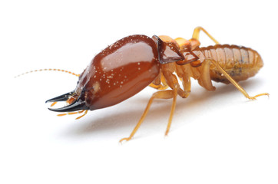
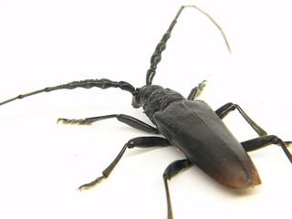
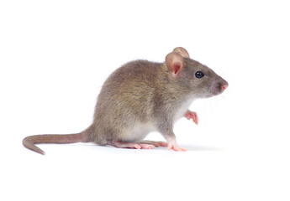
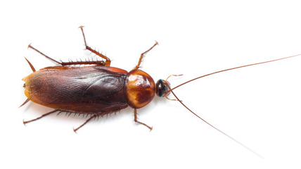
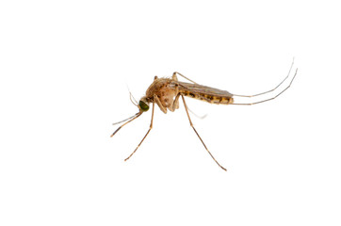
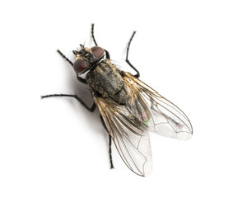
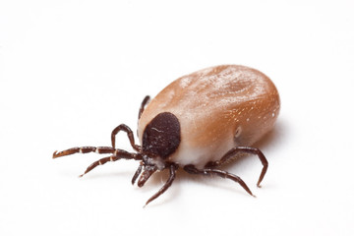
Efficacy assessment of biocidal products against urban pests in the frame of Regulation (UE) N°528/2012
Authors: Nabila HADDACHE, Mathias BRIZARD, Isabelle ATTIG, Catherine BILLAULT, Yann MAXIMILIEN, Alice MUFFAT-JOLY
Regulated Products Assessment Department - U2EB - ANSES, Maisons-Alfort (France)
Keywords: Biocide Regulation 528/2012, Urban pests, Efficacy and resistance assessment
Biocidal products are necessary for the control of urban pests that are harmful to human or animal health and for the control of those that cause damage to natural or manufactured materials. Several product types (PT) exist for controlling urban pests. In Europe, all biocidal products are progressively being framed by a marketing authorisation. Most of the products for which an authorisation already is granted belong to PT8 (wood preservatives), PT14 (rodenticides), PT18 (insecticides) and PT19 (repellents and attractants).
Adobe Stock
The making available on the market and the use of biocidal products is framed by Regulation (UE) N°528/2012 of the European Parliament and of the Council of 22 May 2012 (BPR). The purpose of this Regulation is to improve the free movement of biocidal products within the EU while ensuring a high level of protection of both human and animal health and the environment. Several conditions must be fulfilled for granting an authorisation. Once authorized, the product must be used in accordance with the Summary of product Characteristics (SPC)
Conditions for granting an authorisation related to efficacy assessment
Product is shown to be sufficiently effective according to Art. 19 (1) b of the BPR
Efficacy is defined as the ability of a product to fulfil the claims made for it when used according to the directions for use on the proposed product label (as given in the SPC).
Guidance on the BPR: Volume II Efficacy - Assessment and Evaluation (Parts B+C) describes the BPR obligations and how to fulfil them. It provides technical scientific advice on how to asses and evaluate the efficacy to establish the benefit arising from the use of biocidal products and that it is sufficiently effective.
No unacceptable effects on the target organisms, in particular resistance or cross- resistance or unnecessary suffering and pain for vertebrates according to Art. 19 (1) b of the BPR.
The topic of resistance is discussed in the general part of the TNsG* on Product Evaluation (Section 6). Information on resistance should be given for active substances and biocidal products.
In section “Occurrence of resistance and resistance management“ of the assessment reports. These sections are generally filled in with literature review.
TNsG*: Technical Notes for Guidance
Efficacy assessment conclusions
The evaluating body shall, on the basis of the evaluation carried out in accordance with the principles set down in the Annex VI of the BPR, come to a conclusion as to:
Whether or not it is established that the biocidal product complies with the criteria laid down under point (b) of Article 19(1).
Where the development of resistance or cross-resistance to the active substance in the biocidal product is likely, the evaluating body shall consider actions to minimise the consequences of this resistance. This may involve modification of the conditions under which an authorisation is given. However, where the development of resistance or cross-resistance cannot be reduced sufficiently, the evaluating authority shall conclude that the biocidal product does not satisfy criterion (ii) under point (b) of Article 19(1).
A biocidal product intended to control vertebrates shall not normally be regarded as satisfying criterion (ii) under point (b) of Article 19(1) unless:
death is synchronous with the extinction of consciousness, or
death occurs immediately, or
vital functions are reduced gradually without signs of obvious suffering.
For repellent products, the intended effect shall be obtained without unnecessary suffering and pain for the target vertebrate.
Extract of a Summary of Product Characteristics
Use description
Instructions for use
Product Type | 18
Where relevant, an exact description of the authorised use
Target organism (including development stage) | Crawling insects including: - cockroaches (B. germanica, B. orientalis), adults - ants, adults Pests of stored products: - Confused floor beetle (Tribolium confusum), adults - Rice weevil (Sitophilus oryzae), adults
Field of use | Indoor
Application method | Surface spraying
Application rate(s) and frequency | 0.5 mL/m² (equivalent to 0.1 g a.s./m²) Biocidal effect appears within a few minutes Residual efficacy : up to 2 weeks 2 applications per year maximum
Category(ies) of users | Professionals
Pack sizes and packaging material
Comply with the instructions for uses. Respect the recommended application doses. Inform the authorization holder if the treatment is ineffective. Do not clean the treated area until the treatment is finished. Take into account the life cycle and characteristics of target insects to adapt treatments. In particular, target the most susceptible stage of the pest, timing of applications and areas to be treated. Adopt integrated pest management methods such as the combination of chemical, physical control methods and other public health measures, taking into account local specificities (climatic conditions, target species, conditions of use, etc.). Avoid exclusive repeated use of insecticides from the same chemical subgroup. Alternate products containing active substances with different mode of action (i.e. from other IRAC Mode of Action groups). The product has to be applied only on restricted areas on surfaces not regularly cleaned, for example: behind or under the fridge, under the kitchen sink, under the oven or the water heater, in all cracks and crevices that can be a harbourage for cockroaches.

