Slide 1
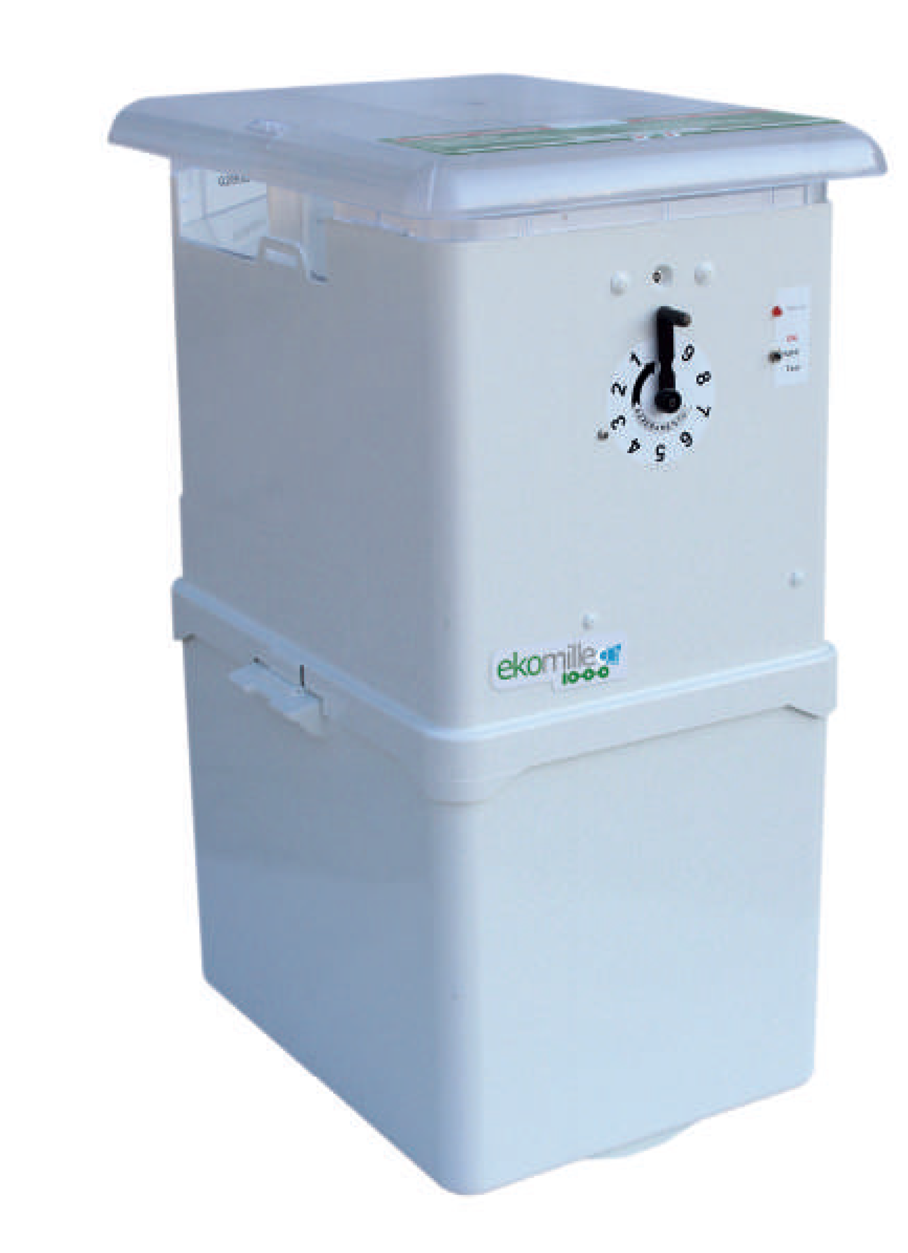
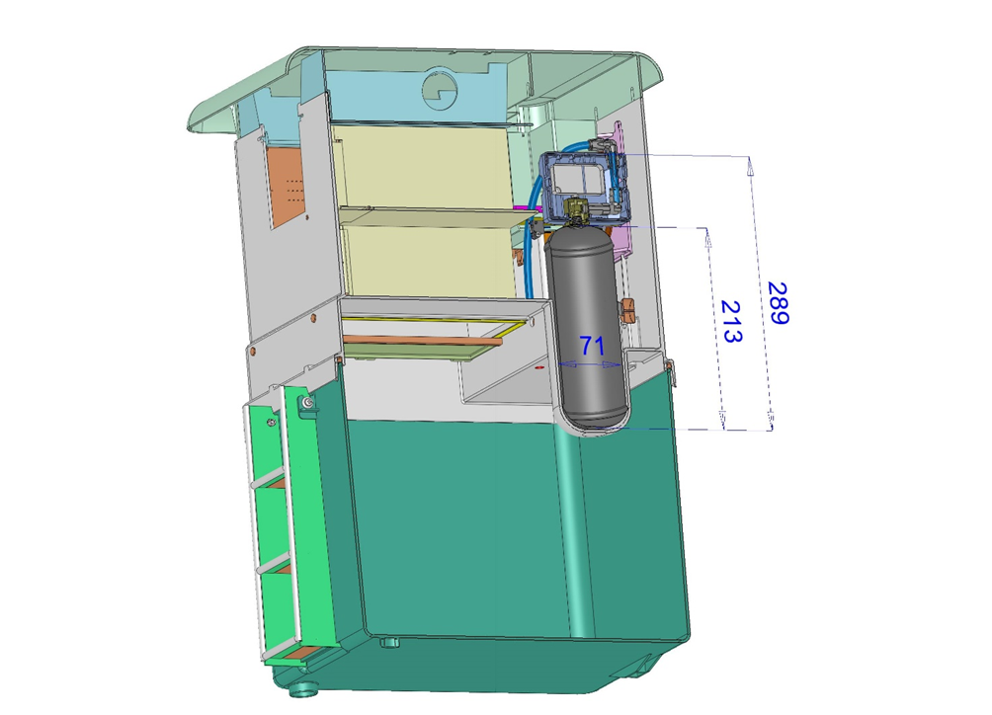
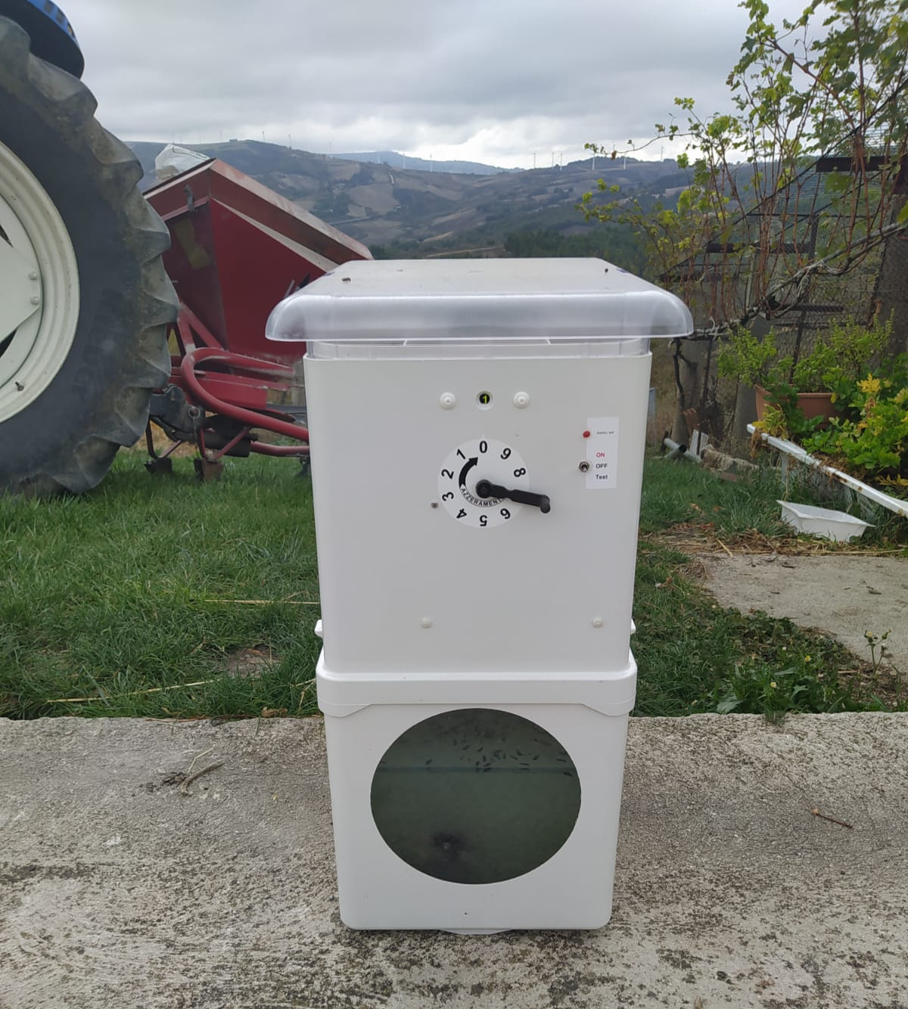
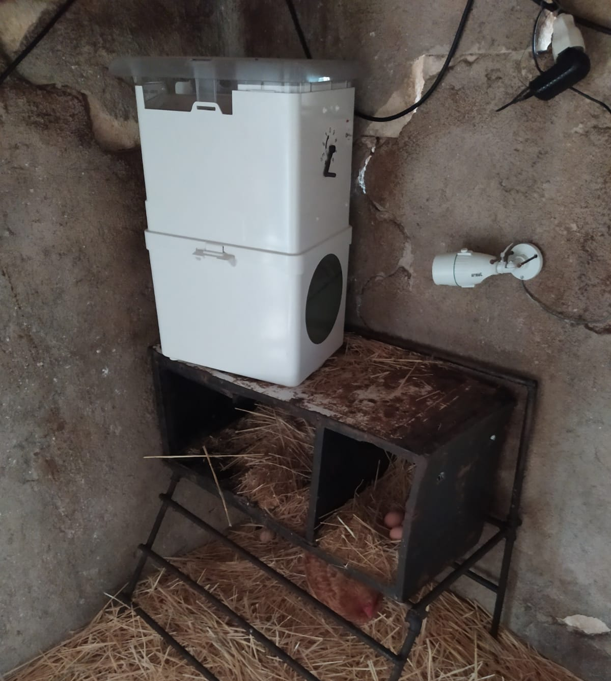
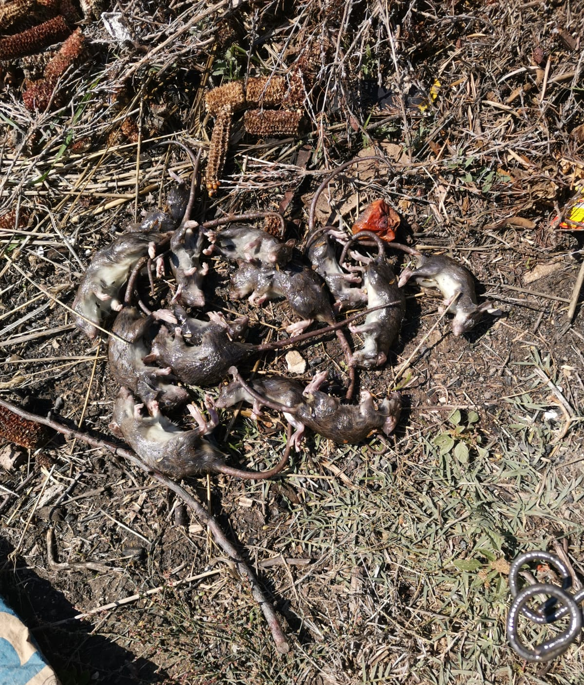
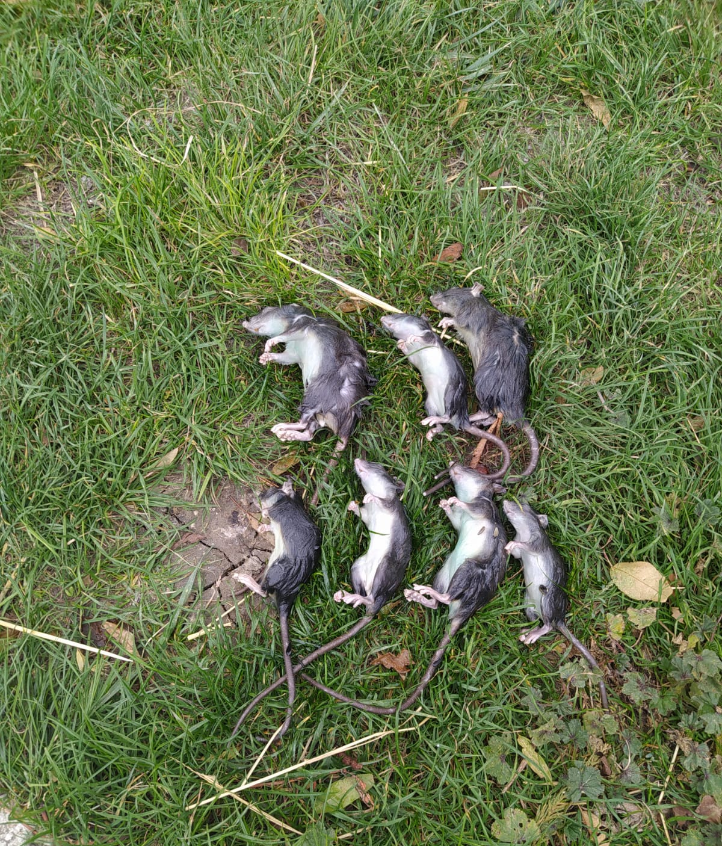
Evaluation of the new suppression system Ekomille CO₂®, for animal friendly rodent management.
Spina Giuseppe PhD – Ekommerce Srl, Via Venezia 18, Atessa (CH) Italy. E-mail: giuseppe.spina@ekommerce.it
Drago Andrea PhD – Entostudio Srl, Via del lavoro 66, Ponte San Nicolò (PD) Italy. E-mail: drago@entostudio.com
Introduction
Rodentia is the biggest family in the order of Mammalia, with over 40% of the species. Few species of rodents are strictly associated to human, and they are cause of serious directly and indirectly damages, by consuming or fouling stored products, acting as disease vectors or destroying infrastructure. In this contest, Rodent Management is essential, to preserve human safety. The available trapping systems in the market like glue traps, or snap trap, not guarantee a human suppression for rodent trapped, however other types like electronic traps or carbon dioxide single catch trap ensure a human death but can do only single catch.
Carbon Dioxide is widely used for the euthanasic suppression of rodents in laboratory. In Europe this aspect was first regulated with the Directive 86/609/EEC and actually, is operative Directive 2010/63/EU.
The effect of the inhalation in animals of Carbon Dioxide was observed by Hyckman in 1824 (Lumb & Jones, 1973). Especially in the 80s, it has become evident that administration of Carbon Dioxide can was a fast and safe euthanasia method, because the induction of unconsciousness is rapid (Forslid et al., 1986; Forslid 1987; Forslid & Augustinsson, 1988). The inhalation of concentrations of CO₂ higher than 70% (Green, 1987; Forslid et al., 1986; Blackshaw et al., 1988; Danneman et al., 1997), to obtain quick loss of consciousness, followed by death of the animals.
In the present work are reported the results of the trials of new suppression system Ekomille CO₂®. The test was made to evaluate for each carbon dioxide bottle, the capacity of the carbon dioxide to suppress in a human mode 10 Rats.
Results
The site where Ekomille 1 was placed was very infested and the whole carbon dioxide was dispensed during the first night of trapping. The first catch was recorded on the 18th of October, at 20.05. The last event happened at 02.50 of 19th of October with a total of 14 rats trapped. The data in the table 1 show how the time necessary for the complete loss of consciousness and the death of the rats has remained stable during all the catches the previous tests conducted in the absence of rodents. It is interesting to note how the high level of infestation permitted several double catches.
No difference is visible in the time needed to kill rats of different ages, as both young and adult rats were killed in 20-30 seconds.
Ekomille 2 began to capture on October the 19th at 13.13, concluding the 10th catch 48 hours later. This trap too showed how always less than 30 seconds were necessary to kill the rats, independently of the age of the individuals (Tab. 2). The site where this trap was installed was clearly less infested respect the previous site and in fact double catches never happened.
The Ekomille 3 began to catch on October the 20th at 8.18 pm, concluding the cycle of 10 captures along several nights, with the final event on October the 28th at 4.37 am. In this case too the time necessary for the complete loss of consciousness and the death of the rats has remained permanently below the 30 seconds, without any influence of the age of the rat (Tab. 3)
TABLE 1
Date | H. m. | Event | Killing time
18/10/2021 | 20.05 | Double catch | 30 seconds
18/10/2021 | 20.49 | Double catch | 20 seconds
18/10/2021 | 21.22 | Catch | 30 seconds
18/10/2021 | 22.35 | Double catch | 30 seconds
18/10/2021 | 22.58 | Catch | 25 seconds
18/10/2021 | 23.18 | Catch | 30 seconds
19/10/2021 | 00.31 | Double catch | 30 seconds
19/10/2021 | 01.40 | Catch | 20 seconds
19/10/2021 | 02.50 | Catch | 30 seconds
Conclusions
The data collected by the three different traps were very homogeneous as never the time to kill a rat was above the threshold of 30 seconds.
The results obtained are in line with the data reported by the international scientific bibliography.
At the end of the experiment, the population of Rattus rattus initially present in the stable was completely eradicated.
In light of what has been observed, the Ekomille, equipped with the carbon dioxide suppression system, is effective as a tool for the capture and rapid suppression of trapped rodents.
Ekomille CO₂® is able to provide 10 catches with a single bottle of 350 grams of CO₂
Ekomille CO₂® is a biocide rodenticide, reg. n. IT/2022/00792/AUT.
TABLE 2
Date | H. m. | Event | Killing time
19/10/2021 | 19.13 | Catch | 25 seconds
19/10/2021 | 20.17 | Catch | 20 seconds
19/10/2021 | 21.25 | Catch | 15 seconds
19/10/2021 | 22.50 | Catch | 15 seconds
19/10/2021 | 23.53 | Catch | 25 seconds
20/10/2021 | 03.20 | Catch | 20 seconds
20/10/2021 | 05.49 | Catch | 25 seconds
20/10/2021 | 16.32 | Catch | 25 seconds
21/10/2021 | 04.40 | Catch | 30 seconds
21/10/2021 | 19.35 | Catch | 15 seconds
Materials & Methods
The tests were conducted in a small private stable located in the municipality of Motta Montecorvino (FG) Italy, intended for the breeding of farmyard animals (laying hens and rabbits) severely infested by black rat (Rattus rattus).
To perform the test 3 Ekomille CO₂® traps have been used, equipped with a carbon dioxide (pure gas 99,99%) can containing 350 g.
18 liters of hydroalcoholic solution were loaded in the lower section in such a way as to cushion the fall of the trapped rodent and reduce the volume to be saturated with carbon dioxide, so as to obtain an atmosphere with a high CO₂ content after each dispensing.
The lower section has been appropriately modified, inserting a transparent porthole in order to verify the effectiveness of the suppression system and the relative time to reach death. All the Ekomille were baited with natural foods like sunflower seeds and pine nuts.
References and cited literature
Blackshaw JK, Fenwick DC, Beattie AW, Allan DJ (1988). The behavior of chickens, mice and rats during euthanasia with chloroform, carbon dioxide and ether. Laboratory Animals 22, 67-75.
Danneman PJ, Stein S, Waishaw SO (1997). Humane and practical implications of using carbon dioxide mixed with oxygen for anaesthesia or euthanasia of rats. Laboratory Animal Science 47, 376-8.
Forslid A. (1987). Transient neocortical, hippocampal and qmygdaloid EEG silence induced by one minute inhalation of high concentration CO2 in swine. Acta Physiol. Scand., 130, 1-10.
Forslid A., Augustinsson O. 1988. Acidosis, hypoxia and stress hormone release in response to one-min. inhalation of 80% CO2 in swine. Acta Physiol. Scand., 132, 223-231.
Forslid A, Ingvar M, Rosen I & Ingvar DH (1986) Carbon dioxide narcosis: the influence of short-term high concentration carbon dioxide inhalation on EEG and cortical evoked responses in the rat. Acta Physiol. Scand., 127, 281-287
Green CJ (1987). Euthanasia. In: Laboratory Animals: An Introduction for New Experimenters. In: Tuffery AA, edl. Chichester: John Wiley & Sons, pp171-7.
Lumb WV, Jones EW (1973). Veterinary anaesthesia, pp. 136, 454. Philadelphia: Lea & Febiger
TABLE 3
Date | H. m. | Event | Killing time
20/10/2021 | 20.18 | Catch | 20 seconds
20/10/2021 | 20.40 | Catch | 30 seconds
20/10/2021 | 22.04 | Catch | 25 seconds
21/10/2021 | 00.13 | Catch | 25 seconds
21/10/2021 | 01.08 | Catch | 25 seconds
21/10/2021 | 20.19 | Catch | 20 seconds
22/10/2021 | 04.08 | Catch | 30 seconds
23/10/2021 | 04.58 | Catch | 20 seconds
26/10/2021 | 21.54 | Catch | 25 seconds
28/10/2121 | 04.37 | Catch | 20 seconds

