Slide 1
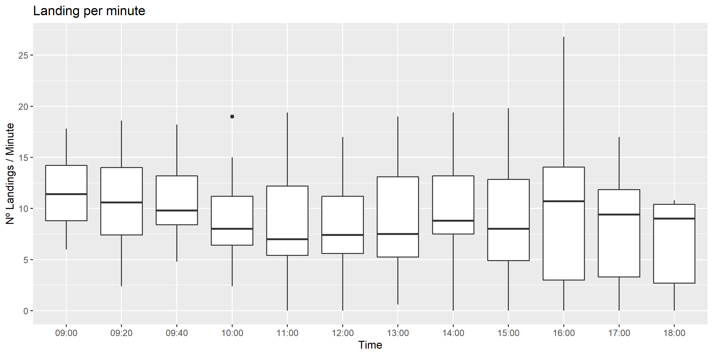
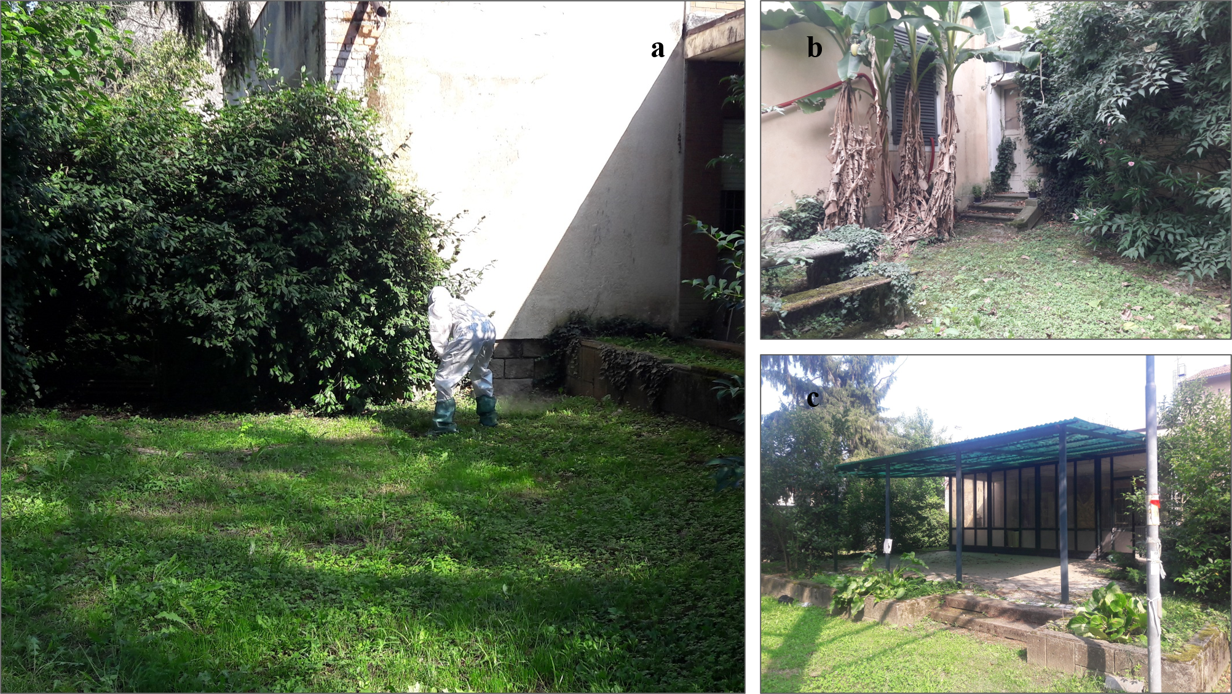
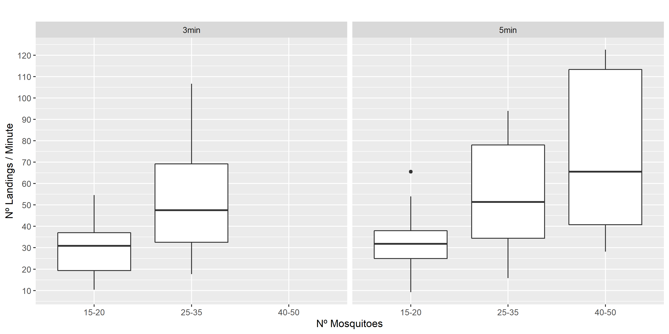
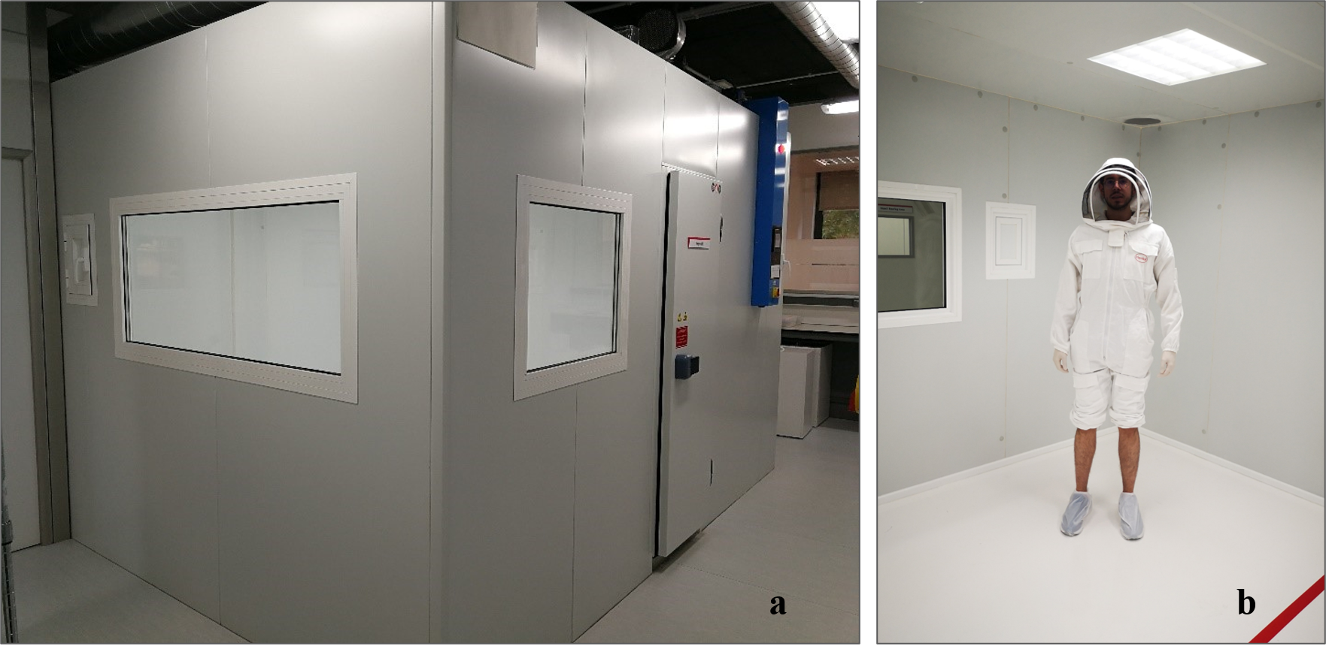
THE MOSQUITO LANDING RATE AS A CONNECTION PARAMETER BETWEEN LABORATORY AND FIELD SETTINGS
M. Moreno-Gómez ^{(1*)}, R. Bueno-Marí ⁽²⁾, M. A. Miranda ⁽³⁾
Henkel Ibérica S.A, Research and Development (R&D) Insect Control Department, Barcelona, Spain. * Attending author: mara.moreno@henkel.com
Laboratorios Lokímica, Departamento de Investigación y Desarrollo (I+D), Valencia, Spain
Applied Zoology and Animal Conservation Research Group, UIB, Palma de Mallorca, Spain
Vector-borne diseases have increased in importance becoming a human health concern at global level. For many of these diseases no vaccines are available, then, the personal protection products and the vector control programs will remain essential tools for protection against transmission.
In Europe, insecticides and repellents are strictly regulated and before any of them can be authorized and marketed, they must meet the high standards of human, environmental and efficacy requirements that the Biocidal Products Regulation requests. Since 2017, The European Chemical Agency is reviewing and updating the guidance for the Product Type 19, where attractants and repellents are included.
The objective of the study was to determine the conditions required to obtain, under laboratory conditions, a similar landing pressure obtained in a natural high infested area of our target mosquito, Aedes albopictus.
• Field Test
• Laboratory Room Test .
In total, 88 observations and 19,163 landings were recorded during the room test. When participants were exposed to 15–20 mosquitoes for 3 min, the total number of landings ranged from 31 to 164; when the exposure time was 5 min, the total number of landings ranged from 46 to 328. When participants were exposed to 25–30 mosquitoes, landing number ranged from 53 to 320 for 3 min of exposure and from 79 to 470 for 5 min of exposure. Finally, when participants were exposed to 45–50 mosquitoes for 5 min, landing number ranged between 141 and 613 (Fig. 4).
• Field Test Versus the Laboratory Room Test
The mean landing rate obtained in the field test was 9.50±1.06 landings/min. In total, 53.4% of the observations fell into the lowest category of >10 landings/min (range: 0–9.8 landings/min), while just two observations (0.9%)—20.2 and 26.8 landings/min—fell into the highest category of >20–30 landings/min. It was therefore considered that the maximum landing rate obtained during the field test (26.8 landings/min) should be the target rate, representing the highest landing rate that might be experienced in an area highly infested with Ae. albopictus.
Introduction
Results
In total, 221 observations were recorded during the field test. There were 10,922 landings across all the trials with all the participants over the 2 d of the test. The mean landing rate was 9.50±1.06 landings/min (range: 0–26.8, Fig. 3).
This research was carried out in two different settings—in the field and in the laboratory—using humans as study participants.
The field test was carried out in September 2018 in a green landscaped zone within a hospital complex located to the southwest of Padua (Veneto region, Italia) (Fig. 1). To assess the landing pressure at field level, 16 volunteers participated in the study, which took place over two consecutive days between 9:00 and 18:00.
Results from the field were compared to those obtained at the laboratory in a 30 m³ cabin at Henkel’s R&D Insect Control Laboratory, Spain (Fig. 2). To evaluate the relationship between mosquito number and landing rate, nine participants were exposed to different levels of mosquito abundance: 15–20 (density of 0.50–0.66/m³), 25–30 (density of 0.83–1.00/m³), and 45–50 (density of 1.50–1.66/m³).
In the room, the temperature and relative humidity were always kept at 25±2 ºC and 60±5%, respectively; the ventilation rate was equivalent to renewing the air in the room 2.5 times per hour, simulating an ‘open windows’ situation. Each day before starting the test, the room was checked for insecticide contamination.
Material and Methods
Fig. 3. Mean temperature and relative humidity recorded hourly from 10:00 to 18:00 over the two consecutive days of the field test during which the landing rate of Aedes albopictus was measured.
Fig. 1. (a) Study participant in an experimental plot wearing a protective suit and waiting for the exposure period to start; (b) experimental plot located in a courtyard; (c) experimental plot located in a covered patio. The vegetation consisted of ornamental plants, common garden shrubs, and trees.
Fig. 4. Mean and SD of landing rate for the different levels of mosquito abundance and durations of exposure in the room test. The trial using 45–50 mosquitoes and a 3-min exposure period was not performed for ethical reasons. The whiskers represent the data that fell beyond the first and third quartiles (Q1 − 1.5 × IQR and Q3 + 1.5 × IQR), and the single point is an outlier.
We succeeded in replicating outdoor high mosquito landing pressure in indoor laboratory conditions using 0.5-0.66 mosquitoes/m³. To our knowledge, this is the first study to compare the landing rates of a mosquito species in both the field and the laboratory. Also, it provides useful values for the development of the European guidance and allow us to define new parameters, requirements and methodologies to evaluate Spatial and Topical repellents against mosquitoes in the laboratory simulating field conditions.
Conclusions & Further Research
Fig. 2. (a) Outside view of the 30 m³ testing room at Henkel’s R&D Insect Control Laboratory; (b) participant wearing a protective suit while inside the testing room.

