Slide 1
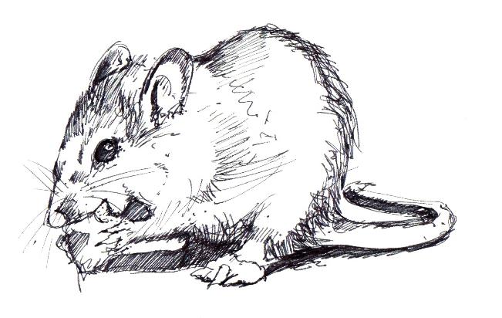

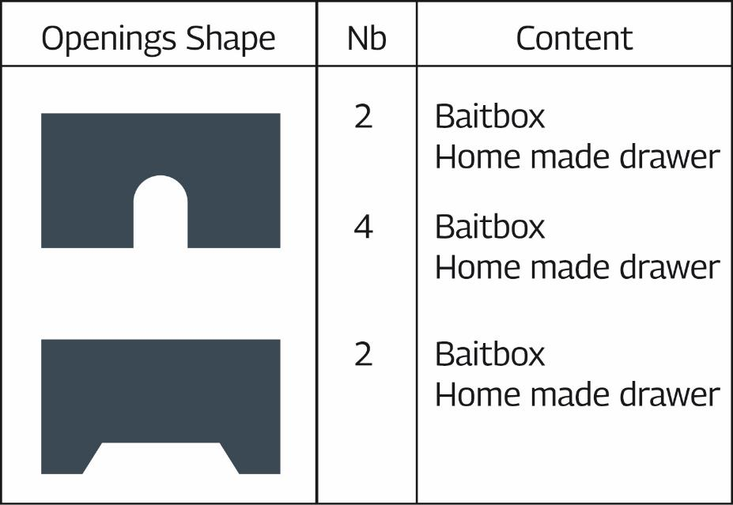
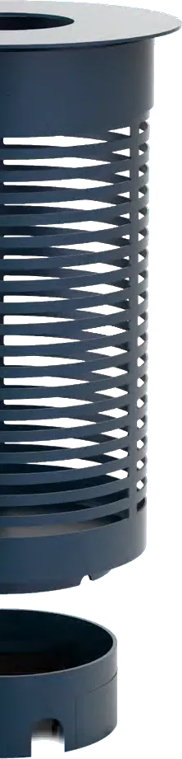
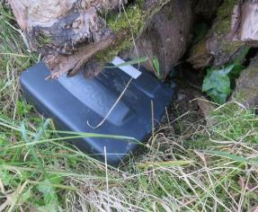
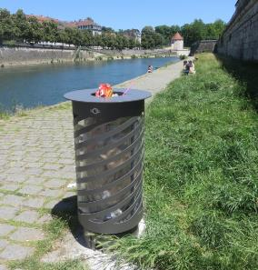


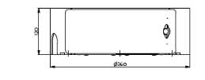
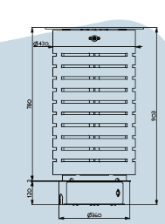
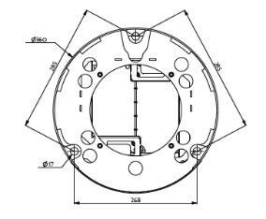

SECU-RAT, a public litter bin accessory as a new tool to monitor and control rat populations in the urban environment – EFFICACY STUDY.
Mickael Sage ^{1,2}, Philippe Riehling ¹, Julien Hoffmann ¹, Vincent Schaller ¹, James Dat ¹
¹ SECU-RAT, 25 rue de la Grette – 25000 BESANCON – France ² Faune INNOV’ R&D, 25 rue de la Grette – 25000 BESANCON – France / contact@secu-rat.fr
INTRODUCTION
Rats pose a significant problem to society (zoonoses, severe property damage and food loss^{)1, 2.} The urban environment favours high population density, especially of the Brown rat (Rattus norvegicus). Increasingly high infestation levels are observed, in particular where human presence is high (e.g. urban parks, along riverbanks, where birds are fed or on picnic spots). Due to high food availability and the presence of attractive habitats in these areas, rat population control is particularly difficult and often ineffective.
SECU-RAT
Responds to the challenge of laying rodenticide baits and traps exactly where they are needed in an urban outdoor environment: under public bins.
Adapted for distance monitoring of rat populations and allows room for traps or rodenticide
baits that can only be accessed once it has been opened with a key.
Offers a high level of tamper-resistance for children and non-target animals (see the poster ‘Safety considerations for children, dogs and urban birds’), and is perfect for sensitive accounts where discretion is essential
Because optimal efficiency is required, prototypes were tested and implemented in different conditions and cities. We studied efficacy of each prototype according to rat detection frequency and placebo bait consumption and compared to classical bait boxes placed in similar settings.
Public bins are a crucial issue because they offer food to rats, but also because they fit into the urban outdoor environment and are often placed near rat habitats such as flowerbeds, bushes, etc
MATERIAL & METHODS
RESULTS
6 prototypes
Opening shape and number
No difference of frequentation according bait consumption
=> 2 small openings (safety choice)
Presence detection of rodents
Placebos
Rodenticides
Placebos
Openings
Nb.
Shape
Content
SECU-RAT vs Bait boxes
Bait box
Efficacy 100%
2
Home made drawer
4
Bait box
Home made tiroir
2
Bait box
Protocol of evaluation
Home made drawer
THE PRODUCT
Inspired from guidance on the
Biocidal Products Regulation
Bait consumption
S235 steel / 6,4 kg
Electro-galvanisation
Protected against corrosion
by a baked polyester powder coating
Stainless steel assembly screws 304L
Comparison with bait boxes in strategic areas
Amount of bait consumed
Motion detection
Video tracking
Placebos
Rodenticides
Placebos
Tested in real conditions
Efficacy 100%
Exemple of compatible litter bins
Green spaces and bushes
Flowering meadows / flowerbeds
Stream banks and bodies of water
Car parks
Picnic areas / Children’s play areas
Manufactured in France to ensure quality and durability, SECU-RAT is patented and compatible with different litter bin models and will be distributed internationally
Strand, T.M., and A. Lundkvist. 2019. Infection Ecology & Epidemiology, 9:1.
Pimentel, D., L. Lach, R. Zuniga, and D. Morrison. 2000. Bioscience. 50. 53-65.

